Slide 1
Starter Module 1 My teacher and my friends
----------------- -------------
Unit 3 This is my friend.

Slide 2
学 习 目 标
学习本单元新单词及短语:this ,she ,teacher ,friend ,her ,his
nice ,to ,meet ,time ,go ,now ,bye ,see ,tomorrow;
1
能够介绍自己的朋友；
2
通过听说训练，感受与同学之间真挚的友情。
3

Slide 3
课 堂 导 入
T:Good morning.What’s your name?
S: Good morning.I am…
S:My name is…
T:Can you spell it, please?
S:Yes, xxxx.
T:How are you?
S:I am fine，thank you.

Slide 4
Enjoy a song
Make New Friends.mp4

Slide 5
This is my friend.
Her name’s Miss Li.
= She's Miss Li .
Greet with Miss Li ：
Good morning, Miss Li.
Nice to meet you.
How are you?

Slide 6
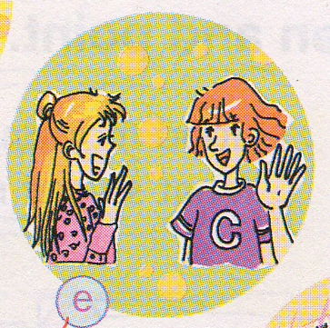
This is my friend, too.
Her name’s Lingling.
= She's … .
Good morning, ... .
Nice to meet you.
How are you?

Slide 7
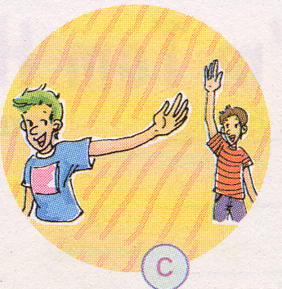
This is my friend, too.
His name’s Tony.
= He's … .
Hello, Tony.
Nice to meet you.
How are you?
-- It’s time to go now. Goodbye.
-- Bye. See you tomorrow.

Slide 8
Pair work
This is my friend.
Her name’s …
she's=she is
She's....
This is my friend.
His name's ... .
He's ...
he's = he is

Slide 9
课 堂 学 习
1
Listen and read.
Lingling: This is Miss Zhou. She’s my teacher. Hello, Miss Zhou.
Miss Zhou: Hello, Lingling.
Lingling: Miss Zhou, this is my friend, Tony.
Miss Zhou : Hello, Tony.
Tony : Hello, Miss Zhou.

Slide 10
Lingling: This is my friend. Her name’s Betty.
Tony: Hello, Betty.
Lingling: This is my friend. His name’s Tony.
Betty: Hello, Tony, nice to meet you.
Lingling: It’s time to go now. Goodbye, Tony.
Tony: Bye. See you tomorrow.

Slide 11
Language points
1. This is Miss Zhou. 这是周老师。
（1）这是用来介绍他人的常用句型。当向对方介绍第三者时，常用“This is+姓名”这一句型，而不能说She is...或He is...。如果介绍距离较远的人时，用That is...介绍。
This is my mother. 这是我的妈妈。
（2）当介绍多人时用These are...，如果介绍距离较远的多人时，用Those are...句型。
These are my parents and those are my uncles.
这是我父母，那是我叔叔们。
【注意】this is不能缩写成this’s。

Slide 12
2.Hello, Tony, nice to meet you.你好，托尼，见到你很高兴。
Nice to meet you.是双方初次见面时的礼貌用语，也可以用于双方很久未见，偶然相逢的场合。其答语为Nice to meet you too.
--Hello, Tim. Nice to meet you.你好，蒂姆。见到你很高兴。
--Hello, Amy. Nice to meet you too.你好，埃米。见到你我也很高兴。
【拓展】meet 动词 遇见；结识
Let’s meet at 9:00. 让我们9点见面吧。
3. It’s time to go now. 现在该走了。
It’s time to do sth. 意为“该做某事了；到做某事的时间了”。它是一个固定句型，有时可以换成It’s time for sth.或It’s time for doing sth.。若表示“某人该做某事了”，应用It’s time for sb. to do sth.。
It’s time to have class.
→It’s time for （having） class. 该上课了。
It’s time for her to clean the blackboard.她该擦黑板了。

Slide 13
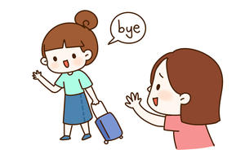
4. See you tomorrow. 明天见。
See you tomorrow.是告别用语，常用“See you+时间”来告别。回答也用同样方式说或简单说See you.。
—See you next week. 下周见。
—See you （next week）. （下周）再见。

Slide 14
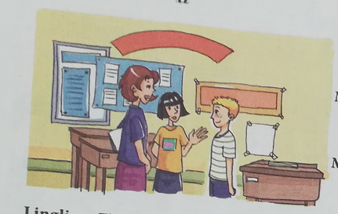
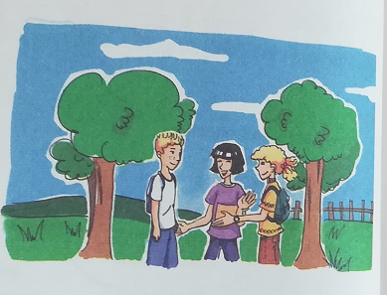
2
Listen again and repeat.
1
2

Slide 15
3
Match.
1.This is my friend .
2.She is my friend.
3.Hello.
4.It's time to go now.
a.His name's Tony.
b.Goodbye.
c.Nice to meet you .
d.Her name's Betty.
Now listen and check.

Slide 16
4
Listen and number.
5
1
4
2
3
5
Listen again and say.

Slide 17
6
Work in groups .Say.

Slide 18
7
Write.
His
friend
name's
meet
Goodbye
tomorrow
Now listen and check.

Slide 19
Group work
A: Hello!
B and C: Hello!
A: This is my friend (B). Her / His name ’s …
C: Hello, B.
A: B, this is my friend(C). Her / His name ’s …
B : Hello, C. Nice to meet you.
C. ...
B. How are you?
C: …
B: …
A: It's time to go now, goodbye.
B and C: Bye, see you tomorrow.

Slide 20
课 堂 达 标
Ⅰ. 用所给词的适当形式填空。
1. Betty and Lingling (be) at school.
2. He is my brother. (he) name is Jill.
3. It’s time (do) my homework.
4. (she) mother is our English teacher.
5. Hello, Maria. They are my good (friend).
are
His
to do
Her
friends

Slide 21
Ⅱ. 单项填空。
1. Dad, my teacher, Mr Hu.
A. he is B. she is C. this is D. this’s
2 —Hello, 8765432. Who is that?
—Hello. Tim.
A. This is B. I am C. That is D. My name’s
3. I have a pen friend (笔友). Amy.
A. Her name B. She name C. She name’s D. Her name’s
4.—I’m Frank.
—Nice to meet you, too.
A. How are you? B. Hello, John!
C. Nice to meet you. D. Good afternoon!
5. —See you tomorrow, Sara.
— , Jenny.
A. See you tomorrow B. I’m fine
C. Thanks D. How are you
6. My sister is a teacher. works in a school.
A. Her B. He C. I D. She

Slide 22
Homework
1.Practise the dialogue in Activity 1.
2.Write down the words on the exercise books.

Slide 23
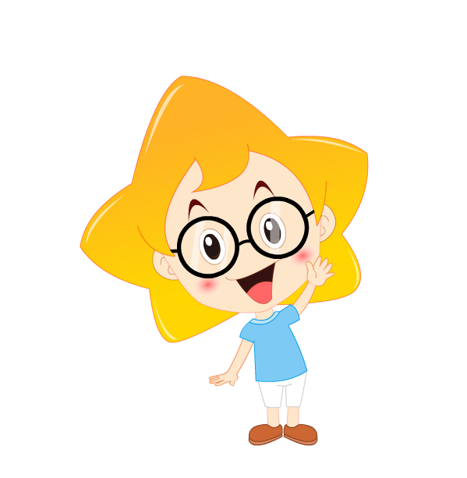
Thank you !

