Slide 1
Unit 5 第5课时
三年级

Slide 2
Unit 5 Do you like pears?
B Let’s talk

Slide 3
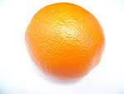
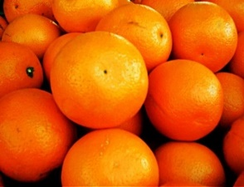
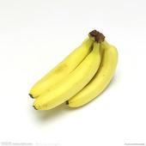
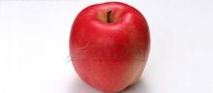
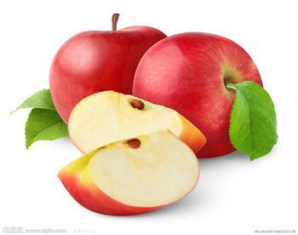
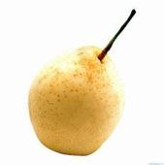
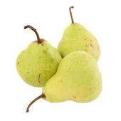
an orange
oranges
a banana
bananas
an apple
apples
a pear
pears

Slide 4
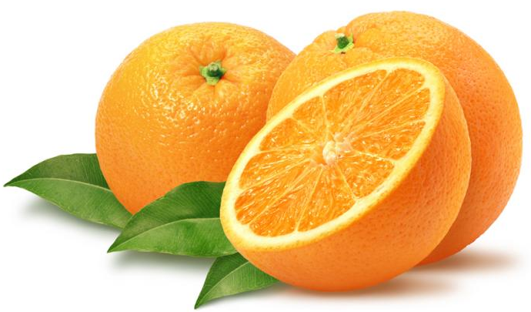
Do you like oranges?
Yes, I do.
No, I don’t.

Slide 5
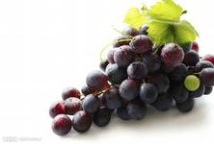
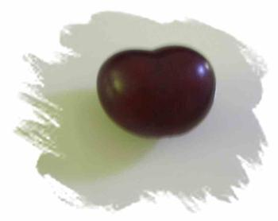
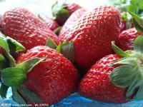
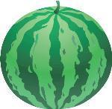
grape
grapes
strawberries
strawberry
watermelon
watermelons

Slide 6
考考你们！

Slide 7
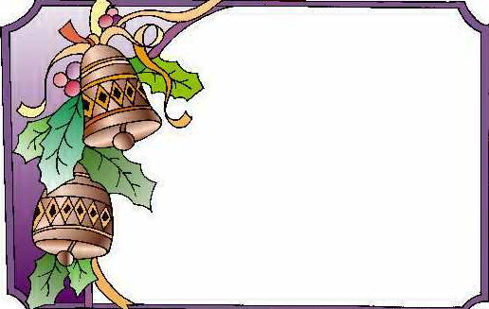
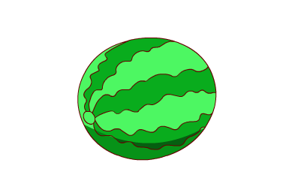
Riddles 谜语
①
看着是 green，
吃着是 red ，
吐出是 black。
（猜一种水果）
watermelon

Slide 8
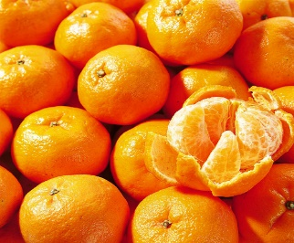
Riddles 谜语
③
orange
黄金屋里装黄金船，
黄金船坐黄金人，
黄金人身上带甜酸。
（猜一种水果）

Slide 9
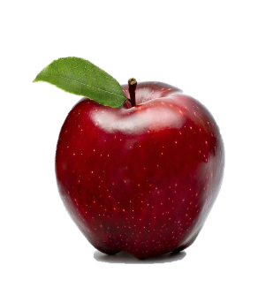
Riddles 谜语
④
红红脸，圆又圆，
亲一口，脆又甜。
apple
（猜一种水果）

Slide 10
Riddles 谜语
⑤
黄包袱，包黑豆，
尝一口，甜水流。
pear
（猜一种水果）

Slide 11
Game
游戏规则：
1、如果你和老师、同学喜欢的水果相同，就请你马上大声说：Me too.
2、如果不相同，就请你马上大声说：
Me neither.
I like …
Me too.
I don’t like…
Me neither.
Notes:
Me too

Slide 12
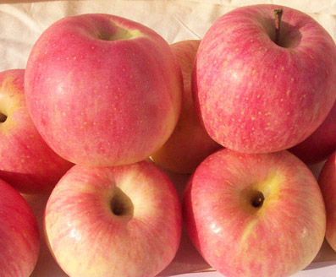
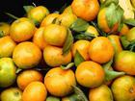
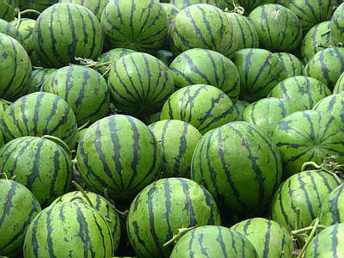
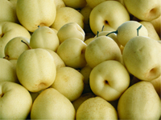
apples
oranges
watermelons
pears
bananas
strawberries
I don’t like watermelons.
I like oranges.

Slide 13
apples
watermelons
oranges
pears
What do you like?
strawberries
I like ____, I don’t like ____.

Slide 14
Group work
小组活动，谈论各自喜爱的水果。
What do you like?
I like______. I don’t like_____.

Slide 15
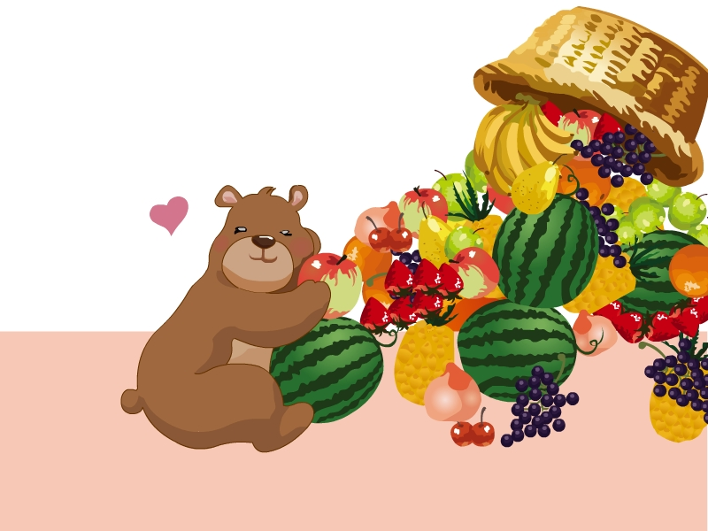
I like….
Me too.

Slide 16
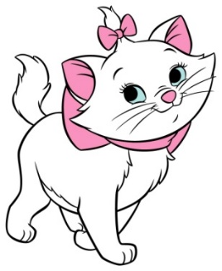
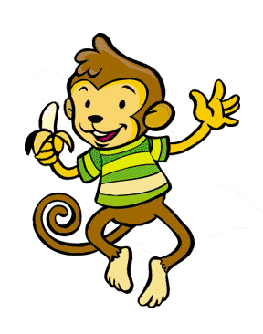
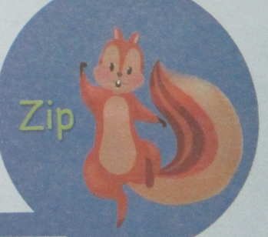
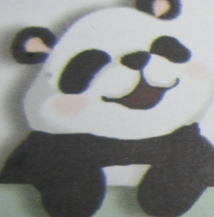
Let’s have a fruit party.

Slide 17
I like grapes.
Have some grapes.

Slide 18
Hello,panda.Do you like grapes?
Here you are.
Sorry, I don’t like grapes.
I like watermelons.
Thanks.

Slide 19
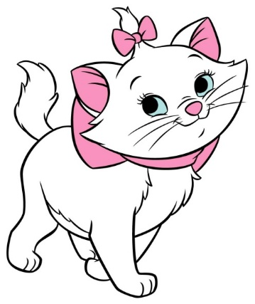
I like bananas.
Can I have some bananas?
Sure. Here you are.

Slide 20
Hello, monkey.
Have some bananas.
Thanks.
I like _______.

Slide 21
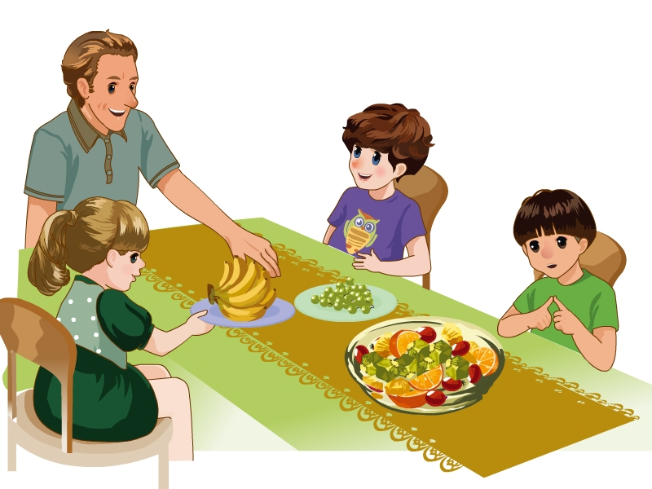
Who are they?
讨论图上的人物是谁? 听录音，回答他们各自喜欢的水果

Slide 22
Have some grapes.
Thanks. I like….
Sorry, I don’t like grapes.
Can I have some…?
Here ….

Slide 23
show time!
我来演一演

Slide 24
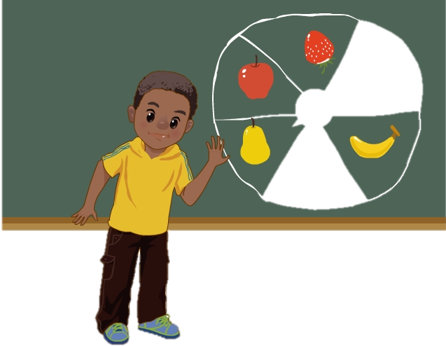
Let’s play
I like ….
I don’t like….

Slide 25
