Slide 1
Unit 4 A good read
Grammar

Slide 2
学 习 目 标
掌握本课时新单词及短语：hand, review, return, hand in, write about, and so on, ask for help with writing, on time
1
学会正确使用“特殊疑问词+ 动词不定式” 结构。
2
学会正确使用must和have to。
3

Slide 3
New words
hand
hand in
v. 交；递，给
上交，递交

Slide 4
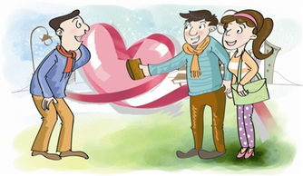
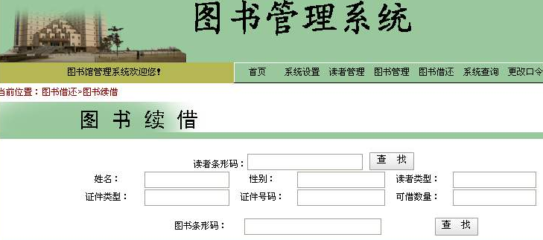
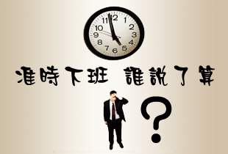
review
return
v.归还
/rɪ'vjuː/
n. 评论
renew
/rɪ'njuː/
on time
v.续借；更新
准时

Slide 5
Revise to-infinitives
To do that kind of thing is foolish。
主语
I want to see you this evening.
宾语
动词不定式
All you have to do is to finish it quickly.
表语
We found a house to live in.
定语
She came here to study English.
状语
He asked the patient not to eat cold water after the operation.
宾补

Slide 6
Using question words + to-infinitives

Slide 7
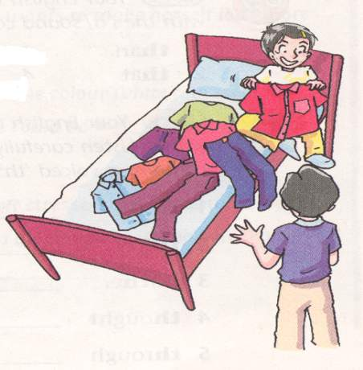
Presentation
Andy doesn't know ____________.
(穿什么)
what to wear

Slide 8
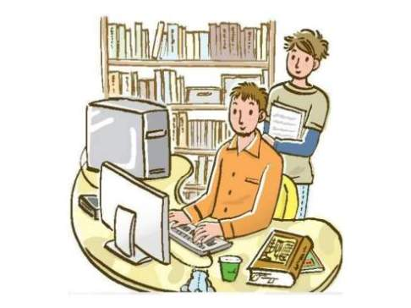
teach
how
borrow books
teaching the boy
The man is _______________(教这个男孩) _____________________ (如何借书）from a library.
how to borrow books

Slide 9
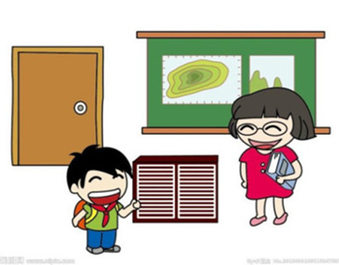
ask
when
hand in
asking the teacher
The boy is __________________ (问老师) __________________________ (什么时候交作业).
when to hand in the homework

Slide 10
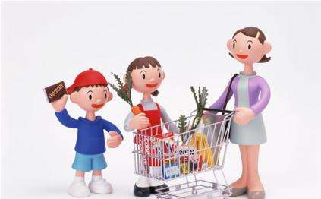
tell
where
go shopping
telling her daughter
Mum is __________________(告诉她女儿)
（去哪里购物）.
where to go shopping.
_____________________

Slide 11
我们可以用疑问词加动词不定式放在动词后做宾语。
We can use a question word with a to-
infinitive after a verb.
e.g.
1. Millie has decided________________(读什么).
2. Daniel did not say _____________(和谁交谈)about this book.
3. Simon forgot ______________(什么时候见)his friends.
4. Kitty cannot decide ________________(选哪一个)first.
5. Sandy is wondering ______________(去哪儿请求)for help.
6. Amy does not know _____________(怎样写)the report.
what to read
who to talk to
when to meet
which to choose
where to ask
how to write

Slide 12
所有疑问词中，只有why不可以与动词不定式连用
All question words can be used in this
way, except why.
Suzy will explain why to recommend
this book.
Suzy will explain why she recommend
this book.
×
√

Slide 13
We can use a verb + object before a question word with
a to-infinitive.
我们可以在疑问词+动词不定式前使用“动词+宾语”。
advise, ask, decide, discuss, find out, forget, know, learn remember, say, show, teach, think, understand, wonder
1. Mr Wu advised us ________________ (选择哪一个) as
after-school activities.
2. The students asked their teacher ______________
(什么时候上交)their work.
3. Millie showed us________________(下一步做什么).
4. Daniel taught himself__________(怎样用)a computer to draw.
5. Don’t forget to tell your mum _______________ (在哪儿接) you.
which to choose
when to hand in
what to do next
how to use
where to meet

Slide 14
We can use a noun after what, which, whose,
how many and how much.
(我们可以在what, which, whose, how many和how much后加上一个名词)
e.g. 1. They are discussing ____________________
(涂哪一个颜色) the walls.
2. You can ask your parents _____________________ (带多少钱)with you.
which color to paint
how much money to take

Slide 15
We can also use an adjective like sure or clear
before a question word.
( 我们还可以在疑问词前用像sure 或clear这样的形容词。)
e.g. Suzy was not sure ______________(向谁请求)help.
Are you clear ___________ (什么时候见面) at the
gate tomorrow?
who to ask for
when to meet

Slide 16
Summary
疑问词+不定式
四种结构
1) 动词+ 疑问词 + to do sth.
2) 动词+ 宾语+ 疑问词+to do sth.
3) 动词+ 疑问词+ 名词+ to do sth.
4) adj. (sure/clear)+ 疑问词+to do sth.
e.g.
I don’t know what to say next.我不知道接下来该说什么。
I can’t decide which to take.我不能决定该拿哪一个。
Please tell me how to get there.请告诉我怎样到那儿。
Are you clear how to get there?你清楚如何到那里吗？

Slide 17
2.“疑问词+动词不定式” 结构在句子中还可以做主语和表语。
1) _________________ (如何处理 ) the waste is still a
hard problem.
2) The problem is ______________ (何时离开)the place.
What to do with
when to leave
3. “疑问词+动词不定式” 结构可以改写成由该疑问词引
导的从句。
e.g. I don’t know what to do.(该做什么)
= I do not know what I should do.
注意：所有疑问句中,只有why不可以与动词不定式连用。

Slide 18
Practice
同义句转换
(1) He did not know where he could find other people.
= _______________
(2)He wondered who he could ask for help.
= _____________________
(3He did not know how he could break the ropes.
= ______________
(4) He found out what he could do with the tiny man.
= ______________
(5) He decided when he should leave Lilliput.
= _____________
(6) I don’t know_________________________________.
(怎么办) =_________________________
where to find
who to ask for
how to break
what to do
when to leave
what I should do /how I should do it
what to do / how to do it

Slide 19
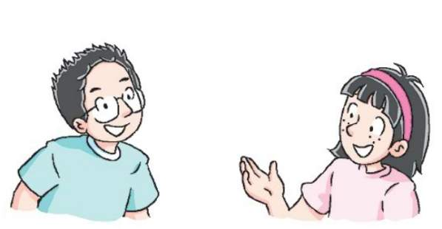
Amy and Daniel are talking about their Reading Week. Complete their conversation. Use the correct question words and to-infinitives.

Slide 20
how, what, ask for, find, when, where, hand in, read, which, who, speak, travel, write about
Amy: Mr Wu has recommended so many interesting books. Have you decided (1) ____________ first, Daniel?
Daniel: Yes. I want to read Black Beauty first. But I don’t know (2) ___________ the book.
which to read
where to find
Amy: You can try our school library or Sunshine Library. Oh, did you know Peter is reading Around the World in Eighty Days? He wants to find out (3) ___________ around the world in such a short time.
Daniel: Wow, that’s amazing! By the way, can you tell me (4)______________ our book report?
how to travel
when to hand in

Slide 21
how, what, ask for, find, when, where, hand in, read, which, who, speak, travel, write about
Amy: Before next Friday. I’m still not sure (5) _________________ in the report.
Daniel: You can write anything about your book – what the
book is about, what you think of it and so on. You
should read some reviews about the book before writing.
what to write about
Amy: Thank you. Anyway, I know (6) _____________
help with writing. Mr Wu is always there to help us.
who to ask for

Slide 22
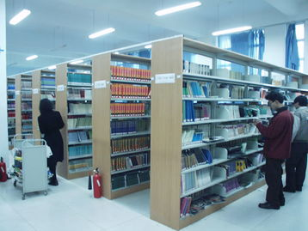
Library Rules
1. I must keep quiet in the library.
2. I want to keep the book longer, but I have to return the book on time.
must 表示主语“必须”做某事，强调说话人的主观意愿。
have to 强调的是客观需要，意思是“不得不,得做某事”。
have to 有人称和数的变化:has to, had to,
will have to

Slide 23
People mustn’t smoke in the library.
mustn’t(禁止)
Do people have to pay for the book in the library?
No, they don’t have to pay for the book in the library.
don’t have to（不必做某事）

Slide 24
Let’s work out the rules!
1.必须做某事（主观意愿）
禁止做某事
2.不得不做某事（客观需要）
不必做某事
must do sth.
mustn’t do sth.
have to do sth.
don’t have to do sth.

Slide 25
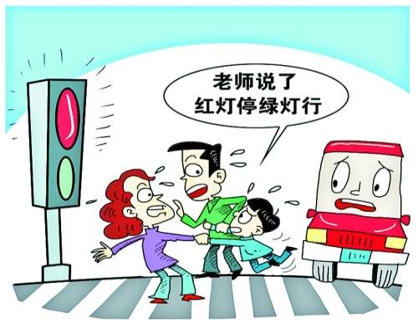
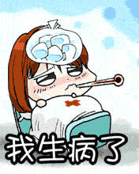
用 must，mustn’t, have to, don’t have to的适当形式填空
mustn’t
People _________ go across the road when the traffic light is red.
People ________ wait for the green traffic lights.
must
主观意愿
客观需要
has to
Her mother ____________ look after her at home because she is ill.
She _______________ have lessons at school.
doesn’t have to

Slide 26
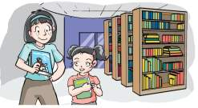
Amy is telling her cousin Shirley some library rules. Complete what she says with must, must not, have to or don’t have to.
You (1) _____ keep quiet in the library.
You (2) _____ keep the books clean and tidy.
You (3) _______ draw or write on the books .
must
must
mustn’t
You (4) _______ eat or drink in the library.
You (5) _____ return the books on time. If you want to
keep them longer, you (6) ______ renew them.
You (7) ____________ bring your student card every time
you go to the library, but remember to bring your
library card.
mustn’t
must
have to
do not have to

Slide 27
拓展
must用在一般疑问句中，肯定回答用______，否定回答用_______ 或 ______________.
must
needn’t
don’thave to
Must I keep the book clean and tidy?
Must I bring my ID card(身份证) when I come here?
Yes, you must.
No, you needn’t.
No, you don’t have to.

Slide 28
注意：must 还可以表示肯定猜测，意思是
“一定” 。表示否定的猜测用can’t。
e.g. You must be hungry after all that walking.
走了那么远的路，你一定饿了吧。
That can’t be Lucy. She has gone to America.
那肯定不是Lucy，她已经去了美国。

Slide 29
用Wh-word 填空
课 堂 达 标
Group competition
where
1.They know ___________ to meet at 8:00 tomorrow.
( where, when)
2.Can you tell us _________ to talk to? (who, where)
3.Do you know _________to fix the computer? (who, how)
how
who

Slide 30
用动词的适当形式填空
1. Sandy wants to know where __________ (ask) for advice.
2. My question is when_______________(start).
3. Could you tell me which____________ (do) first, my homework or my favourite hobby?
to ask
to start
to do

Slide 31
汉译英
1. Jim还没有决定向谁请求帮助。
2. 他们忘了应当什么时间交作业。
who to ask for help
Jim hasn’t decided ____________________.
when to hand in
They forgot __________________the homework.

Slide 32
3.我必须努力学习。
4.她得照看她妈妈，因为她妈妈病了。
5.你一定不要在书上画画或者写字。
I must study hard.
She has to look after her mother , because her mother is ill.
You mustn’t draw or write in the book.

Slide 33
选择正确答案
-Must I return the book today?
-No, you _____.
A. don’t B. can’t C. mustn’t D. don’t have to
2. Students in our school ______ know shouting is
not allowed(允许) in the library.
A. can B. may C. must D. need

Slide 34
Homework
1. Remember the grammar rules in this lesson.
2. Finish the exercise in the workbook.

Slide 35
Thank you !

