Slide 1
Module 7 Computers
Unit 2 When do you use a computer?

Slide 2
学 习 目 标
1
学习本单元单词及短语:share, Australia, company, often, check, train, travel, plan, ticket, music, movie, night, search, search for, information, email, send, sometimes, cinema, clothes, visit
掌握句子 ：What do you do on the computer?/When do you use a computer?/Who shares a computer with his father?
能够学会询问某人（who）在何时（when）何地（where）利用计算机做何事（what）,并能根据问题用第三人称陈述句形式做出回答。
2
3
通过问卷调查，运用所学语言了解同学间使用电脑情况。

Slide 3
课 堂 导 入
Do you often use a computer?
When do you use the computer?
What do you often do on the computer?
What other things can we do on the computer?

Slide 4
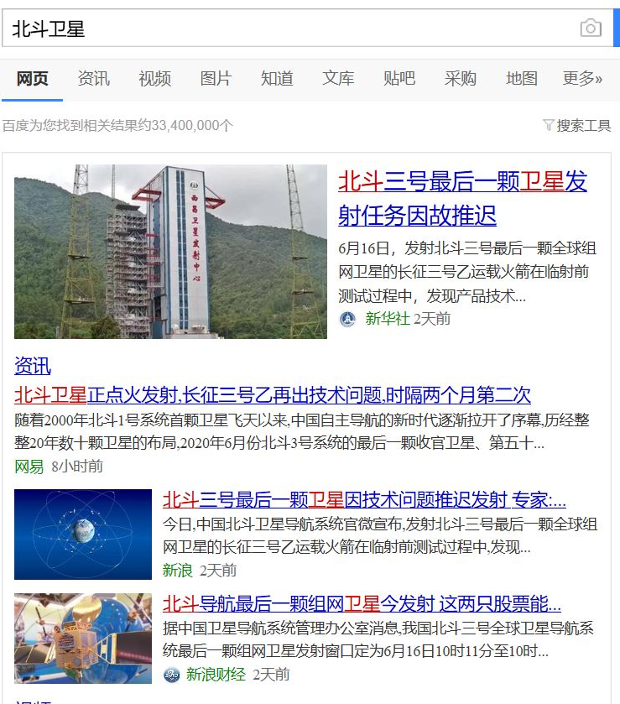
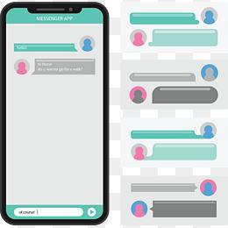
talk with friends
search for information

Slide 5
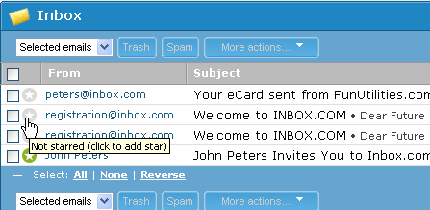
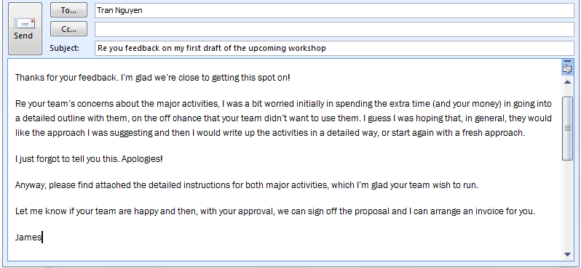
check emails
send emails

Slide 6
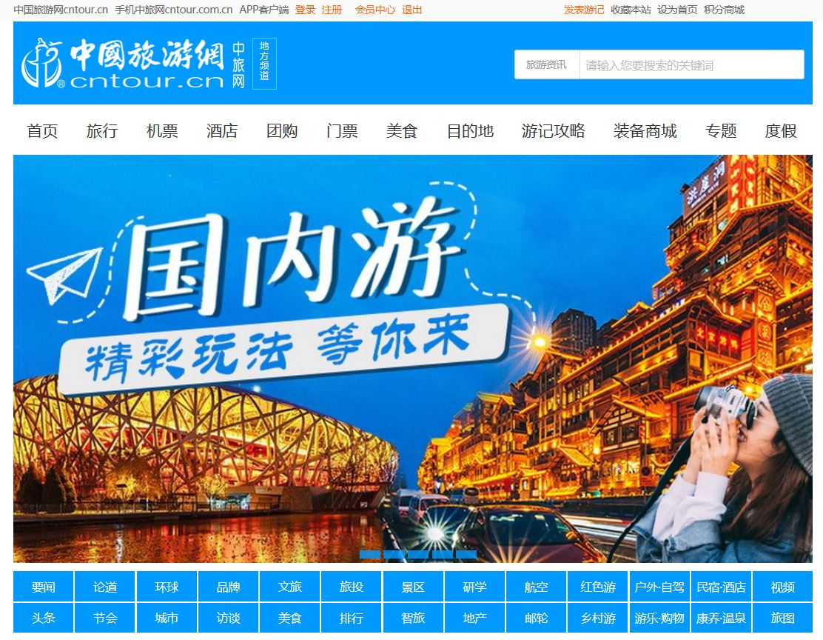
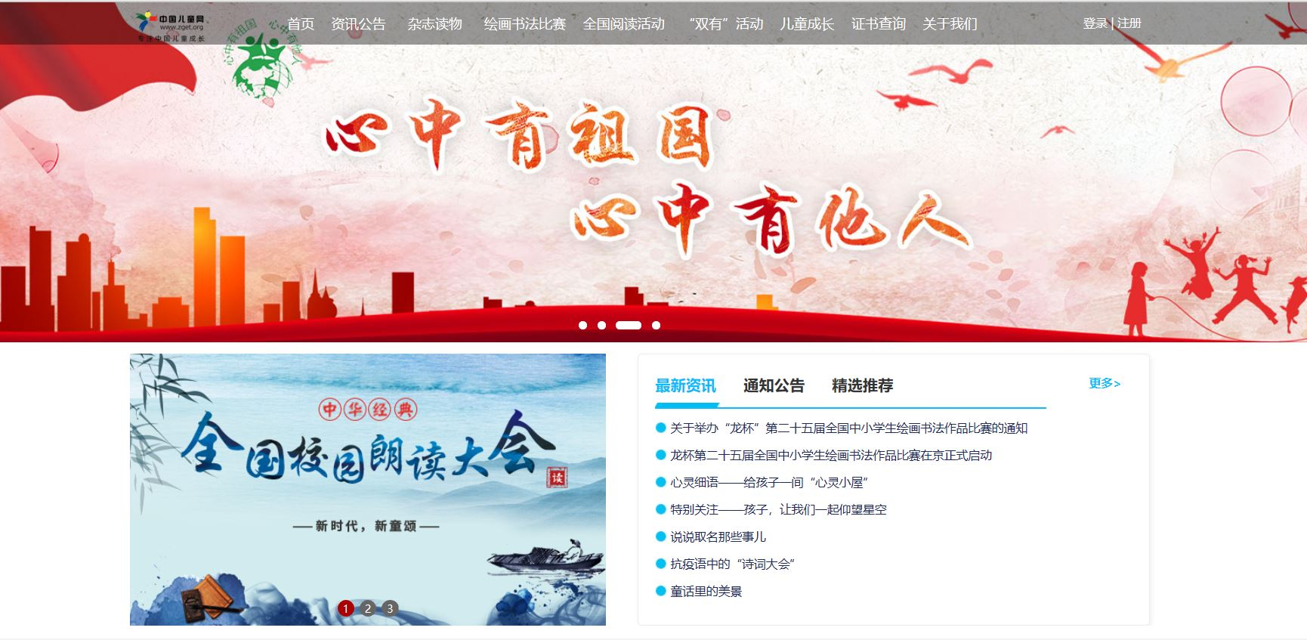
make travel plans
visit a website浏览网页

Slide 7
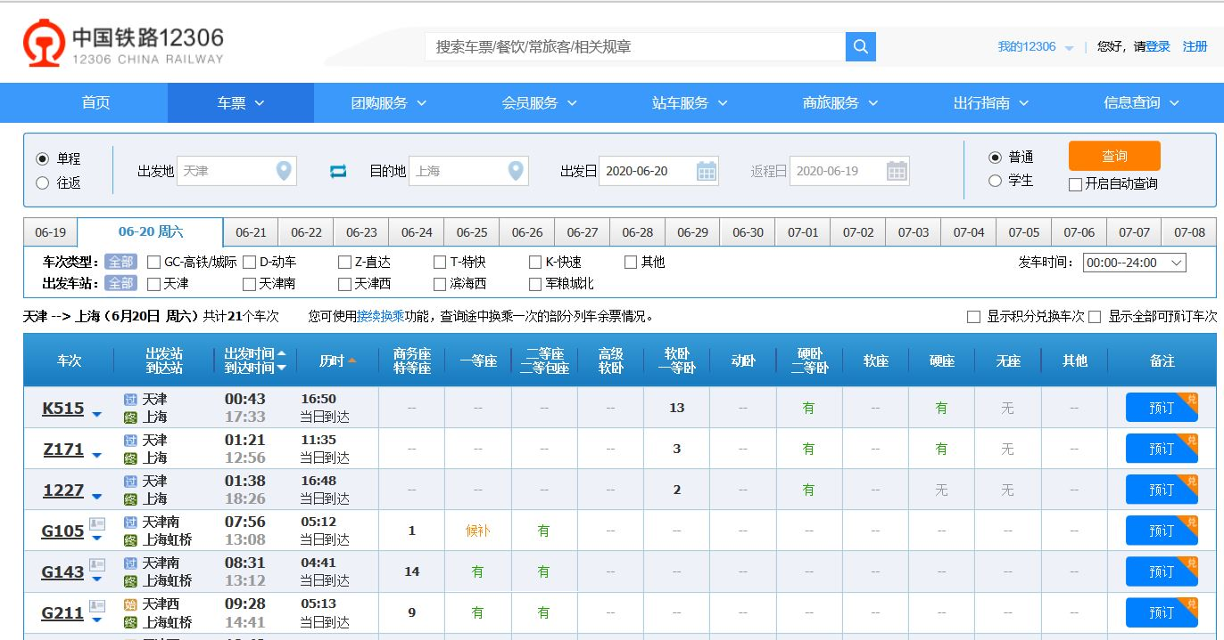
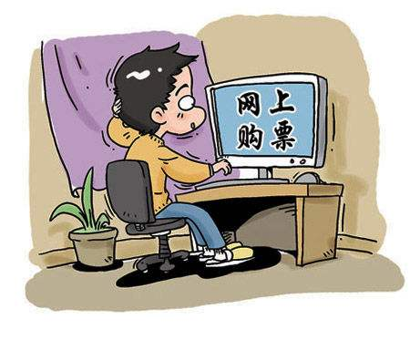
check the times of trains
buy tickets

Slide 8
课 堂 学 习
1
Read the passage and match the questions with the people who answer them.
1 Who can use the computer on Sunday?
2 Who shares a computer with his father?
3 Who has a friend in Australia?
Mike.
Jack.
Alice.

Slide 9
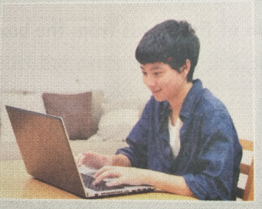
There is a computer in my home, and my father and I share it. My father is a manager of a company, so he often talks to his customers on the computer. He also goes on the Internet to check the times of trains, make travel plans, and buy tickets, I listen to music or watch movies on it every Friday night.
—Zhang Lei

Slide 10
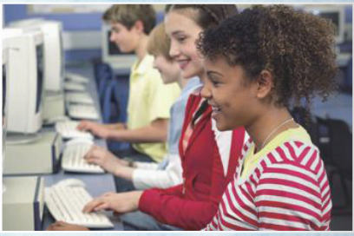
There is no computer in my home. I can only use it at school. On the Internet, I search for information, do my homework and check my email. I have a friend in Australia. I can see her and talk to her on the Internet.
—Alice

Slide 11
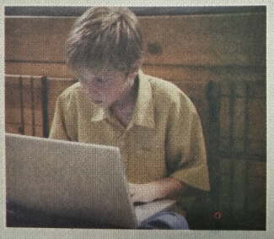
We have a computer at home. My parents don’t use it. I can use it on Sundays. I send email to my friends and play computer games. But sometimes I play a lot of games and my mother doesn’t like it.
—Mike

Slide 12
2
Check(√) the true sentences.
Zhang Lei’s father uses the computer every Friday night.
Alice checks emails at home.
Mike likes playing computer games.
Mike and his parents use their home computer.
×
×
√
×

Slide 13
1. Zhang Lei’s father uses the computer every Friday night.
×
Paragraph 1: I listen to music or watch movies on it every Friday night. — Zhang Lei
2. Alice checks emails at home.
×
Paragraph 2: There is no computer in my home. I can only use it at school. — Alice

Slide 14
3. Mike likes playing computer games.
√
Paragraph 3: I send email to my friends and play computer games. — Mike
4. Mike and his parents use their home computer .
×
Paragraph 3: We have a computer at home. My parents don’t use it. — Mike

Slide 15
Language points
1.…and my father and I share it. ……我和爸爸共用。
share动词，意为“共用；分享”。后面可接名词(短语)或代词作宾语。share sth. with sb. 意为“与某人分享某物”。
Let's share the room. 我们合住这个房间吧!
May I share the umbrella with you? 我可以与你合用这把伞吗？

Slide 16
2. …make travel plans, and buy tickets. ……制定旅行计划，买机票。
（1）travel名词，意为“旅行”。
Do you like your travel to Qingdao?你喜欢你的青岛之旅吗？
【拓展】travel动词，意为“旅行”。
I want to travel to England.我想去英国旅行。
（2）plan可数名词，意为“计划”。
She is making a plan now.她正在制定一个计划。
【拓展】plan动词，意为“计划；打算”。
plan to do sth.计划/打算做某事
I plan to play basketball tomorrow.明天我打算打篮球。

Slide 17
3. On the Internet, I search for information, do my homework and check my email.在网上，我搜索信息、做家庭作业、查看我的电子邮件。
（1）search for意为“搜寻；查找”。
She is searching for her son.她正在找她的儿子。
（2）information不可数名词，意为“信息”。可以用much, a
lot of, some, any等词修饰。
We use the keyboard for typing in information.我们使用键盘键
入信息。

Slide 18
4.I send email to my friends and play computer games.
我给我的朋友发送电子邮件并且玩电脑游戏。
send及物动词，意为“发送，寄”。send sb. sth. = send sth. to sb.意为“发送/寄给某人某物”。
My friend often sends me her photos.
= My friend often sends her photos to me.
我朋友经常给我发来她的照片。

Slide 19
5.But sometimes I play a lot of games...
但是有时我玩很多游戏…… 。
sometimes频度副词，意为“有时,不时”，可位于句首、 句中或句末。
Sometimes my sister writes to me.我姐姐偶尔给我写封信。
6.And do you want to visit friends or family?
你想去拜访朋友或家人吗？
visit动词，意为“探望；参观”。
I want to visit the Great Wall.我想去参观长城。
【拓展】visit名词，意为“参观；访问”。
It’s her first visit to China.这是她第一次来中国。

Slide 20
3
Match the words and expressions in Column A with those in Column B.
buy
check
go on
make
play
share
talk to
search for
watch
work for
a company
a computer
customer
email
games
information
the Internet
movies
tickets
travel plans

Slide 21
Work in pairs.
 | Zhang Lei | Alice | Mike
listen to music
watch movies
search for information
do homework
send email to friends
play computer games
A: Zhang Lei, what do you often do on the computer?
B: I often listen to music and watch movies on the computer.
B: Alice, what do you do on the computer？
A: I...on the computer.
√
√
√
√
√
√

Slide 22
Complete the passage with the correct form of the words from the box.
4
check customer information Internet movie plan search send share ticket
You can use your computer to do lots of things on the (1) ________. You can (2) _______ for
(3) ____________ about things to do. Are you (4) _________ an evening at the cinema? What time does your (5) _______ start and finish?
Internet
search
information
planning
movie

Slide 23
You can (6) ______ on the Internet. What about shopping? Many (7) __________ buy books, clothes and many other things on the Internet. And do you want to visit friends or family? Many people buy train (8) _______ on the Internet. You can also (9)_____ emails or speak to friends. But remember to (10)_____ the computer with your parents!
check
customers
tickets
send
share

Slide 24
Writing
5
Answer the questions.
1. Does your father/mother use a computer?
2. What do you do on a computer?
3. When do you use a computer?
4. Do you play computer games?
What games do you play?
Now write sentences about your answers.
I have a computer at home.

Slide 25
课 堂 达 标
Ⅰ. 根据句意及汉语提示写单词
1. There are a lot of ________ (顾客) in the shop.
2. She has got a small ______ (公司).
3. Uncle John buys three ________(票) on the Internet.
4. I have a friend in _______ (澳大利亚).
5. They want to go to Shanghai by ____(火车).
customers
company
tickets
Australia
train

Slide 26
Ⅱ.单项填空
1.—What about your____ after school?
—I want to play basketball.
A. dinner B. job C. plan D .lesson
2. My teachers often go online to get much ______ about teaching.
A. information B. tickets C. emails D. games
3. Tom often shares his food ________his friend.
A. to B. with C. in D. on
4. Lingling lives in America. She often sends email ________ her friends.
A. at B. for C. to D. about
5. My father often searches ______ some information on the Internet.
A. of B. at C. from D. for
C
A
B
C
D

Slide 27
Ⅲ.根据汉语意思完成句子
1. 你经常上网吗？
Do you often go ____ _____ ________?
2.我家里没有电脑。
There is ______ ________ in my home.
3. 你玩电脑游戏吗？
Do you ______ __________ ______?
4. 不要在教室里听音乐。
Don’t _______ _____ ______ in class. .
5.他们经常在星期天看电影。
They often _______ _____ on Sunday.
on the Internet
no computer
play computer games
listen to music
watch movies

Slide 28
全国青少年网络文明公约
要善于网上学习,不浏览不良信息。
要诚实友好交流,不侮辱欺诈他人。
要增强自护意识,不随意约会网友。
要维护网络安全,不破坏网络秩序。
要有益身心健康,不沉溺虚拟时空。
It is really important for us to use the computer properly(适当地).

Slide 29
Homework
1. Remember the words and phrases.
2. Write a short passage about the computer. Use the title “I have a computer at home.

Slide 30
Thank you !

