Slide 1
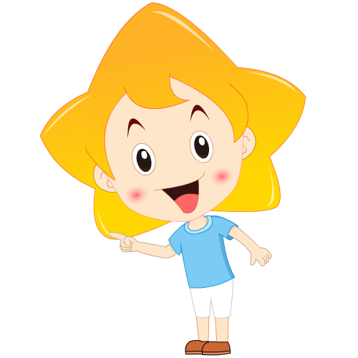
--------------------------- ------------------------
Module 11 Way of life
Unit 3 Language in use

Slide 2
学 习 目 标
总结情态动词must, can, need等的用法；
1
完成课本习题；
2
复习巩固本模块的词汇和句型。
3

Slide 3
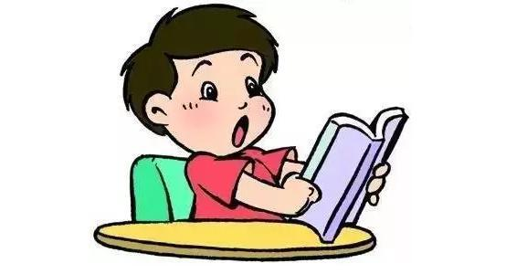
课 堂 学 习
Language practice
You must say Mr or Mrs when you meet someone for the
first time.
You can take it away.
You mustn’t break anything.
You needn’t wait!

Slide 4
情态动词must, can, need等
一、must的用法
must表示“必须；一定”，可用于肯定句、否定句和疑问句。must的否定形式是must not，可缩略为mustn’t，表示“不能；禁止”。
We must clean our classroom every day.
我们必须每天清扫教室。
You mustn’t do any cleaning on the first day of the Spring Festival.
大年初一你一定不能打扫卫生。
Must we wait for them here? 我们必须要在这儿等他们吗？

Slide 5
[注意]
以must开头的一般疑问句，肯定回答通常用must，否定回答通常用needn’t或don’t have to。
--- Must I finish my homework before I go out to play?
我在外出玩耍前必须要完成作业吗？
--- Yes, you must. / No, you needn’t.
是的，你必须（完成）。/ 不，你不必（完成）。

Slide 6
二、can的用法
can表示“许可；可以”，可用于肯定句，否定句和疑问句。can的否定形式是can not或cannot，可缩略为can’t，表示“不能；不可以”，在语气上弱于mustn’t。
You can take the book out of the library. 你可以把这本书带出图书馆。
You can’t write your name here. 你不能把你的名字写在这儿。
Can I have a look at your new camera? 我可以看一看你的新照相机吗？
[拓展]
can除了表示许可或请求许可之后，还常用来表示能力。
I can’t speak Japanese.我不会讲日语。

Slide 7
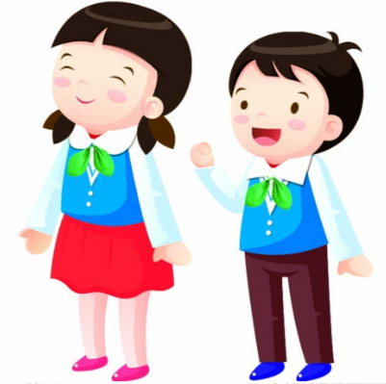
[注意]
以can开头的一般疑问句，肯定回答用can，否定回答用can’t。
--- Can we go home now?
我们现在能回家吗？
--- Yes, you can. / No, you can’t.
是的，可以。/ 不，不行。

Slide 8
三、need的用法
need作情态动词，意为“需要”，可用于肯定句，否定句和疑问句。need的否定形式为need not，可缩略为needn’t，意为“不需要；不必要”。
If you want to look up the words, you need to buy a dictionary.
如果你想查这些单词，你需要买一本词典。
You needn’t worry about your health.
你不必担心你的健康。
Need we ask the policeman for help?
我们需要求助那位警察吗？

Slide 9
[拓展]
need还可用作实义动词，意为“需要”。need sth.意为“需要某物”；need to do sth.意为“需要做某事”。
I need your help.我需要你的帮助。
We need to buy some more food and drink. 我们还需要再买一些食物和饮料。
[注意]
以need开头的问句，肯定回答通常用must，否定回答通常用needn’t。
--- Need I tell Daming about it？我需要把这件事告诉大明吗？
--- Yes, you must. / No, you needn’t. 是的，你必须告诉他。/ 不，你没有必要告诉他。

Slide 10
四、must与have to的区别
(1) must侧重于说话者主观看法，认为有必要或有义务去做某事；must侧重于客观需要，含有“不得不”之意。
We must work hard.我们一定要努力学习。
My bike was broken, so I had to go to school on foot.
我的自行车坏了，所以我不得不步行去上学。
(2) mustn’t 意为“一定不要”；don’t have to意为“没有必要”。
You mustn’t be late for school.你们一定不要上学迟到。
They don’t have to go early.他们不必早去。

Slide 11
1 Complete the conversations with can or can’t.
1 A: Can you drive a car at the age of seventeen in England?
B: Yes, we . How about in China?
A: No, we .
2 A: Can you open a gift immediately after you receive it in England?
B: .What about in China?
A: No, we usually don’t.
can
can’t
Yes, we can

Slide 12
3 A: Can you push your way onto a bus in England?
B: .How about in China?
A: No, we either.
4 A: Can you drive on the right-hand side of the road in
England?
B: .What about in China?
A: Yes, we must.
No, we can’t
can’t
No, we can’t

Slide 13
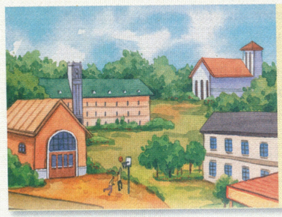
2 Complete the sentences with must or must not.
School rules
1 You be late for school.
2 You eat in the library.
3 You ride your bike in
the playground.
4 You do your homework.
5 You listen to the teacher.
must not
must not
must not
must
must

Slide 14
3 Underline the correct words.
It is important to know what you must and must not do when you meet people from a different country.
You (1) may / must not ask Westerners “How old are you?” because it is not polite. You (2) might / can know someone well, but you (3) must / need not ask “How much money do you make?” He (4) may / can never speak to you again!

Slide 15
In public places, you (5) must / can ask people before you take photos of them, and you (6) must not / might not eat or drink in shops or museums.
In some countries you (7) cannot / can go into someone’s house with your shoes on. You (8) need not / must not take them off. But in some other countries you (9) might / must not wear shoes in the house.

Slide 16
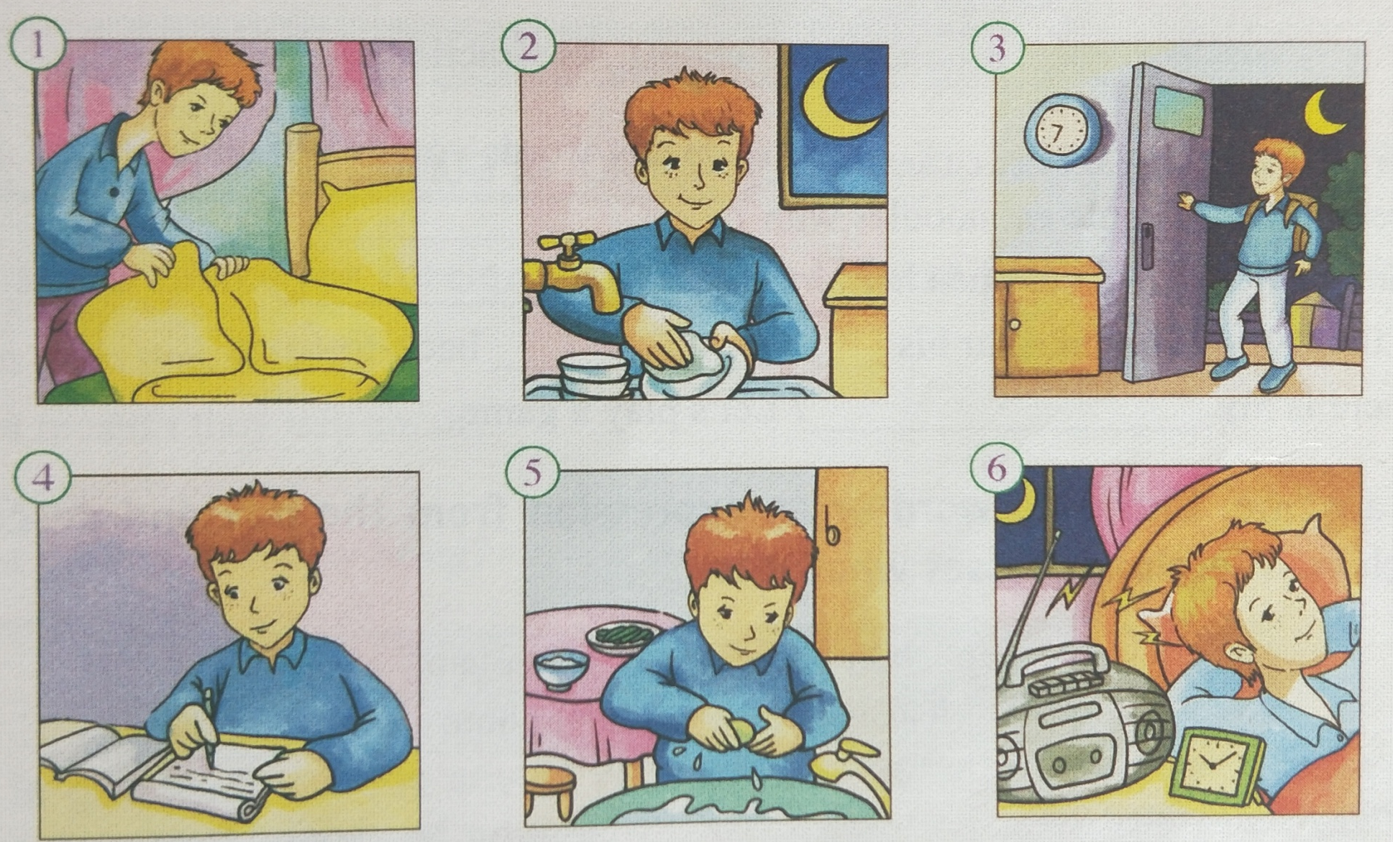
4 Listen to a teenager talking about his life. Check(√) the things he must or mustn’t do.

Slide 17
 | must | mustn’t
1 clean up bedroom once a week
2 wash up after dinner
3 stay out after 9 pm
4 do homework before going out
5 wash hands before dinner
6 play music loudly after 10 pm
√
√
√
√
√
√

Slide 18
5 Listen again. What two things does he say he can do?
1 _____________________________________________
2 _____________________________________________
He can go out with his friends at weekends.
He can play music loudly before 10 o’clock at night.

Slide 19
Tapescript:
Well, my parents are quite strict. I must clean up my bedroom once a week and I must always wash up after dinner. My parents are very strict about that. I mustn’t stay out after nine o’clock at night, but I can go out with my friends at weekends. I must do my homework before I go out and I must wash my hands before dinner. I can play music, but I mustn't play it loudly after ten o’clock at night.

Slide 20
6 Write some things you can, must and must not do at home.
play computer games at weekends.
wash my hands before dinner.
do my homework carefully.
watch TV on weekdays.
read English in the morning.
play football on Saturdays.
go out at night.
I can…
I must…
I must not…

Slide 21
Now work in pairs. Tell each other three things you must do at home and three things you mustn’t do. Are your home rules different or the same?
—I must visit my grandparents once a week. I mustn’t stay up late in the evening.
— ...

Slide 22
7 Complete the sentences with the words or expressions in the box.
baseball cap chess set chopsticks dictionary presents
1 Use your to look up any words you do not understand.
2 Most Chinese people eat noodles with _____________.
3 Jenny could not wait to open her birthday __________.
4 He thinks it is cool to wear his _____________ back-to-front.
5 Where is my____________? Let’s play a game.
dictionary
chopsticks
presents
baseball cap
chess set

Slide 23
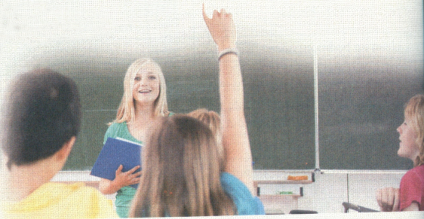
8 Play a game. Choose a word or an expression from the box and describe it to the class. The class guesses what it is.
baseball cap bike chess set chocolate chopsticks dictionary fish and chips litter photo video game
A: Many people have one.
B: Is it a chess set?
A: No, You use it to get to places.
C: Is it a bike?
A: Yes.

Slide 24
Around the world
When you go to a foreign country, it is always best to check what people usually do, so you do not make mistakes.
Traditional presents
In the West, people often take flowers when they visit someone. Different flowers have different meanings. For example, people often give red roses to someone they love. In Greece, you must not give white flowers because that means that someone is dead.
When you go to a foreign country, it is always best to check what people usually do, so you do not make mistakes.
作定语，修饰前面的someone

Slide 25
Module task: Give advice to foreign guests who are visiting a Chinese family
9 Write some advice for foreign visitors to a Chinese family.
Think about:
● What must they wear?
● What mustn’t they talk about?
● What can’t they do?
● What presents can they bring?
● When must they arrive?
…

Slide 26
10 Work in groups. Show the advice you wrote in Activity 9 to your group members. Choose two best pieces of advice.

Slide 27
11 Show the advice your group chose in Activity 10 to the whole class. Put the pieces of advice together to form the advice of the whole class.

Slide 28
12 Then send your advice to your foreign friends or post it on your class blog.

Slide 29
课 堂 达 标
Ⅰ.单项填空
--- Mum, may I play computer games this evening?
--- No way! You ______ finish your homework.
A. can B. must C. may D. will
2. --- Lily, ______ you finish the letter in ten minutes? --- Yes, I can.
A. must B. should C. need D. can
3. --- ______ I return the books this week?
--- No, you ______. You can do that next week.
A. Must; can’t B. May; needn’t C. Need; mustn’t D. Must; needn’t
4. Mo Yan won the 2012 Nobel Prize for Literature ______ the age of 57.
A. at B. in C. on D. to
B
D
D
A

Slide 30
Ⅱ.用括号内所给的单词或短语，将下列句子翻译成英语
1. 不用担心，你可以用我的词典。(can)
______________________________________________________________________
2. 你最好不要晚睡。(stay up late)
______________________________________________________________________
3. 当交通信号灯是红色时，你必须停下。(must)
______________________________________________________________________
4. 他不得不考虑他的健康。(have to)
______________________________________________________________________
5. 我们不必再等了。(need not)
______________________________________________________________________
Don’t worry. You can use my dictionary.
You had better not stay up late.
You must stop when the traffic lights are red.
He had to think about his health.
We need not wait any longer.

Slide 31
Homework
1. Go over what you’ve learnt in Unit 3.
2. Preview the new words and expressions in Module 12.

Slide 32
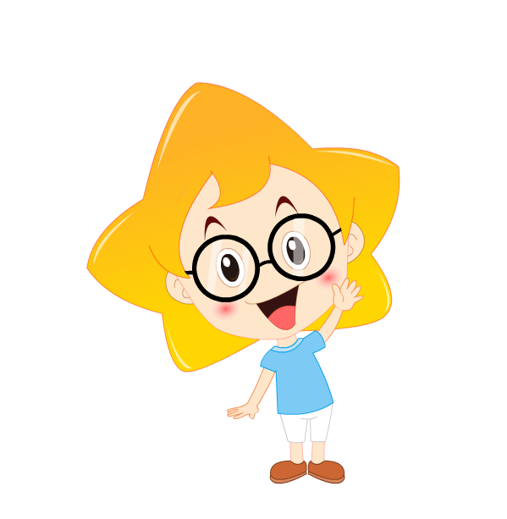
Thank you !

