Slide 1
UNIT 10 If you go to the party, you’ll have a great time!
Section A(1a—2d)
第 1 课 时

Slide 2
学 习 目 标
学习本课时新单词及短语： meeting, video, organize, potato chips, chocolate, potato chips
1
学会对将来要发生的事进行假设和推断
2

Slide 3
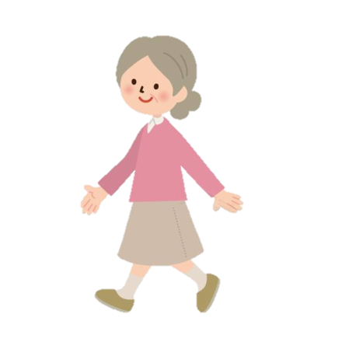
课 堂 导 入
She is going to
walk to school.
She will be late.
If she _____ to school, she _____ ___late.
walks
will
be

Slide 4
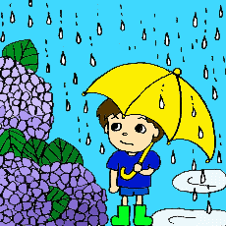
It is going to rain tomorrow.
I will stay at home.
rains
will
stay
If it _____ tomorrow, I _____ _____ at home.

Slide 5
课 堂 学 习
1a
Match the statements with the pictures [a-d].
Statements | Responses
1. ____ I think I’ll wear jeans to the party. | If you do, the teachers won’t _______________.
2. ____ I think I’ll stay at home. | If you do, you’ll _______________.
3. ____ I think I’ll take the bus to the party. | If you do, you’ll ____________________.
4. ____ I think I’ll go to the party with Karen and Anna. | If you do, you’ll ___________________.
c
d
b
a

Slide 6
1b
Listen and complete the responses in 1a.
Statements | Responses
1. ____ I think I’ll go to the party with Karen and Anna. | If you do, the teachers won’t _______________.
2. ____ I think I’ll wear jeans to the party. | If you do, you’ll_______________.
3. ____ I think I’ll take the bus to the party. | If you do, you’ll ____________________.
4. ____ I think I’ll stay at home. | If you do, you’ll ___________________.
let you in
be sorry
be late
have a great time

Slide 7
1c
PAIRWORK
Look at the pictures above and make
conversations.
A: Are you going to the party tomorrow
night?
B: Yes, I am.
A: Who will you go with?
B: I think I’ll go with Karen and Anna.
A: If you do, you’ll have a great time.

Slide 8
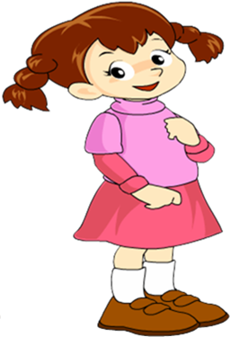
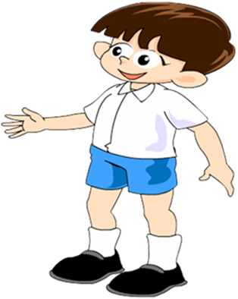
Are you going to the party tomorrow night?
Yes, I am.

Slide 9
Who will you go with?
If you do, you’ll have a great time.
I think I’ll go with Karen and Anna.

Slide 10
2a
Listen and circle the correct answers to complete the sentences.
1. The students are talking about when to have (a class party/a class meeting/ a birthday party).
2. They plan to have it on (Friday evening/ Saturday afternoon/ Saturday evening).

Slide 11
2b
Listen again. Choose the correct short answer in the box to answer each question.
half the class won’t come some students will be bored
make some food students will leave early the party games
1. What will happen if they have the party today?
2. What will happen if they have the party tomorrow?
Half the class won’t come.
Students will leave early.

Slide 12
3. What will happen if they watch a video at the party?
4. What will Mark organize?
5. What will Nelly do?
Some students will be bored.
The party games.
Make some food.

Slide 13
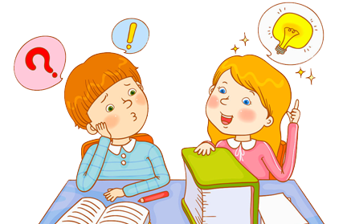
Pairwork
Role-play a conversation between Nelly and Mark.
2c
Let’s have it today.
OK, when is a good time to have the party?

Slide 14
Hmm. If we have it today, half the class won’t come.
Why not have it on the weekend?
Ok, good idea.

Slide 15
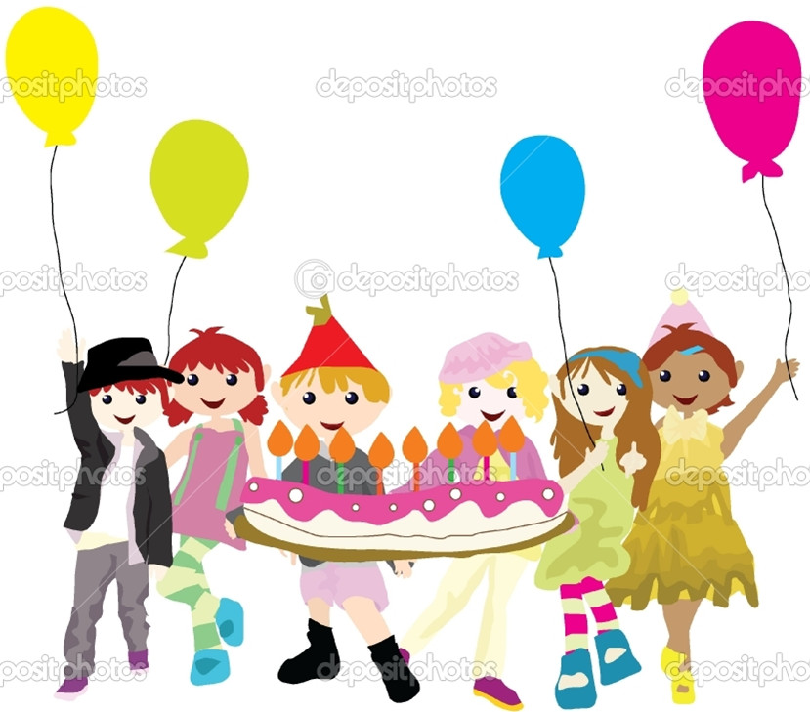
2d
Role-play the conversation.

Slide 16
Make a summer outgoing plan for yourself.
Use: If you go for a summer outgoing
___ Where will you go ?
___ Who will you go with ?
___ How will you go there?
___ When will you go ?
___ What will you take?
___ What shoes will you wear?
Discuss and write a passage:
If we go for a summer outgoing, we will go to _____________________________________

Slide 17
Summary
meeting会议；集会
video录像带；录像
chocolate巧克力
organize组织；筹备
potato chips炸薯条

Slide 18
if 引导一个条件状语从句
当主句是一般将来时时，if 引导的从句必须用
现在时来表示将来可能发生的动作或存在的状态。
If it is sunny tomorrow, we will go to the park. 如果明天天气好,我们就去公园。
If the rain stops tonight, we will go to the cinema.
如果今晚雨停了，我们就去电影院。
If she is kind to me, I won’t argue with her.
如果她好好对我，我就不跟她吵。

Slide 19
课 堂 达 标
I.用所给词的适当形式填空
1. I’m sure if he _________ (go) to the party, he ___________ (have) a great time.
2. I’ll buy a computer if I ______ (have) enough money.
3. You _____________ (not get) nervous if you _____ (do ) enough exercise.
goes
will have
have
won’t get
do

Slide 20
4. Shall I say “Hello” if the foreigner ______ (come) into the classroom?
5. He’ll get better grades if he _________ (study ) hard.
6. If you ______(study) hard, you _____ (can)
pass the exam.
comes
studies
study
can

Slide 21
II.单项填空
1. –What ______ if they ____ to the meeting late?
–Sorry, I don’t know.
A. will happen; go B. happened; go
C. happens; will go D. will happen; will go
A

Slide 22
2. We_______ for a picnic if it_______rain this Sunday.
A. will go; doesn't B. will go; won't
C. go; doesn't
A

Slide 23
Homework
1. Remember the new words and expressions
2. Preview new words and expressions.

Slide 24
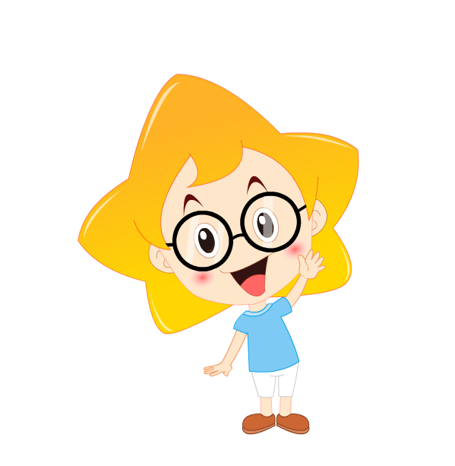
Thank you !

