Slide 1
Unit 2 Ways to go to school
第三课时
六年级

Slide 2
Let's sing
How do you get there?

Slide 3
How do you go to Beijng?
By car.
Take the car.
How do you come to school?
By bus.
Take the bus.

Slide 4
有关交通方式的表达法
take the +交通工具= by+交通工具
如：
I take the bus to school. = I go to school by bus.
我乘坐公交车去学校。
My father takes the car to work. = My father goes to work by car. 我爸爸开车去上班。

Slide 5
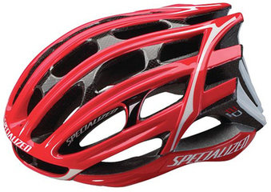
What’s this?
It’s a helmet.

Slide 6
When do we wear helmel?
In the USA, people must wear it on bikes.

Slide 7
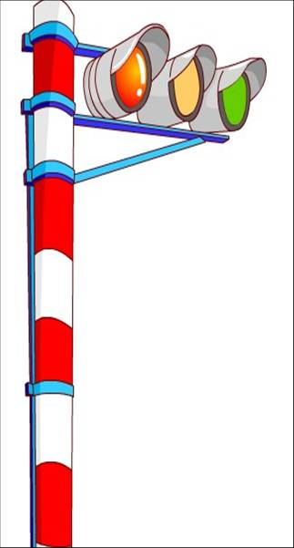
Look at the picture. What’s it?
traffic lights
You must pay attention
to the traffic lights.

Slide 8
Read the conversation and answer questions.
Wu Yifan: Mr Jones, how can I get to the Fuxing Hospital?
Mr. Jones: Take the No.57 bus over there.
Wu Yifan: Thanks. Wow! So many pictures of bikes!
Mr Jones: They’re from my cousin in the USA.
Wu Yifan: What’s this?
Mr Jones: A helmet. In the USA people on bikes must wear one.
Wu Yifan: I see. Oh, the bus is coming! Bye, Mr Jones.
Mr Jones: Hey, don’t go at the red light!
Wu Yifan: Oh, right! Thanks. I must pay attention to the traffic lights!

Slide 9
Answer the questions.
Which bus should Wu Yifan take?
___________________________
2. Where are the pictures from?
___________________________
3. What must we pay attention to ?
___________________________

Slide 10
What do you learn about riding a bike in the USA?
In the USA, we must _______________.
Don’t ______________________.

Slide 11
填一填
1. Don’t go at a r ______ l_______!
2. In the USA, people in the bike must wear a h______.
3. I must pay a_________ to the t_______
l________.
4. The bus is c________.

Slide 12
Make sentences.
Don’t eat in class.
We must listen to the teacher.

Slide 13
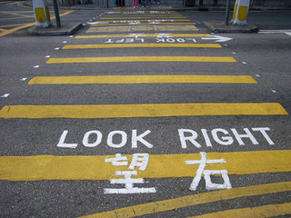
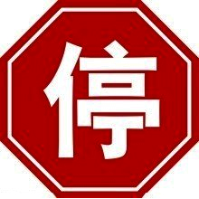
Look at the signs.
Do you know them?
Look right before you
stop

Slide 14
Don’t touch the door.
No right turn.
.

Slide 15
Summary
1. Words and phrases:
over there helmet traffic lights
2. Sentences:
Take the bus over there.
You must pay attention to the traffic lights.
Don’t ... You must ...

Slide 16
Homework
搜寻资料，寻找更多交通标志，也可以是其他国家的交通标志，简要介绍他们的意义，做成一张手抄报。

