Slide 1
Module 12 Help
Unit 2 Stay away from windows and heavy furniture.

Slide 2
学 习 目 标
学习本单元新单词及短语 earthquake, warn, inside, under, window, keep, clear, keep clear of, calm, brave, helpful, power；
1
谈论在地震中的救护措施；
2
灾难中能进行必要和科学的自我保护，并有救助他人的意识和策略。
3

Slide 3
课 堂 导 入
Ask and answer
Do you know how to save yourself when an earthquake happens?
Yes, I learned the correct ways to keep safe during an earthquake.
We should take different measures in different places.

Slide 4
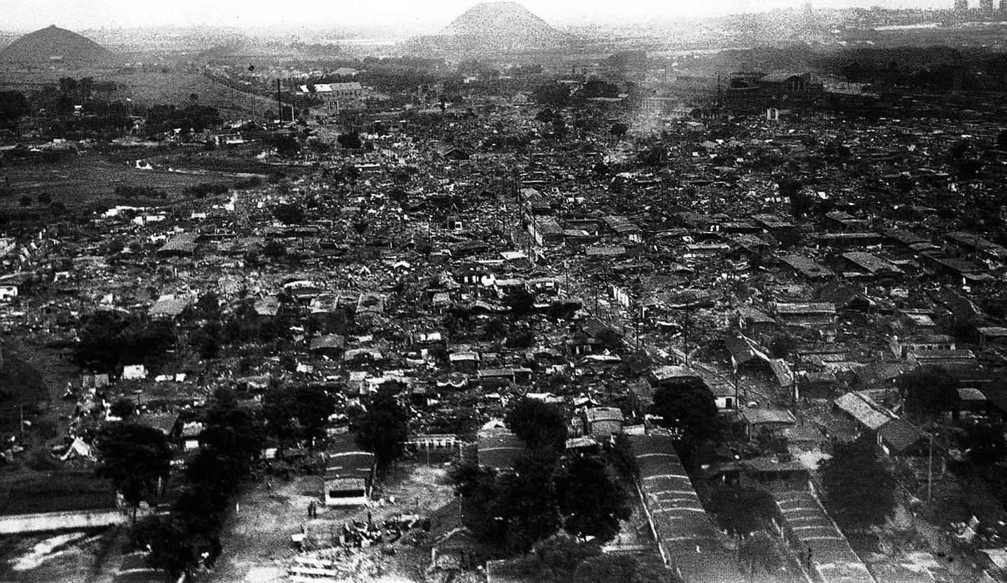
Earthquakes always happen suddenly. They destroy buildings, roads and bridges. And thousands of people may lose their lives during big earthquakes.

Slide 5
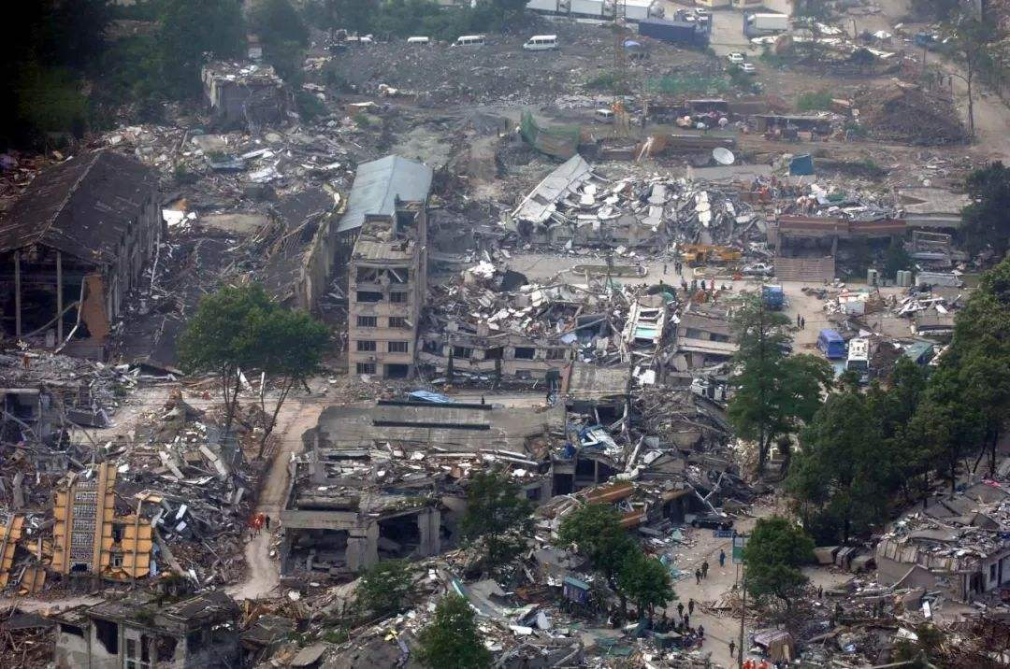
A terrible earthquake happened on May 12 in 2008 in Wenchuan.

Slide 6
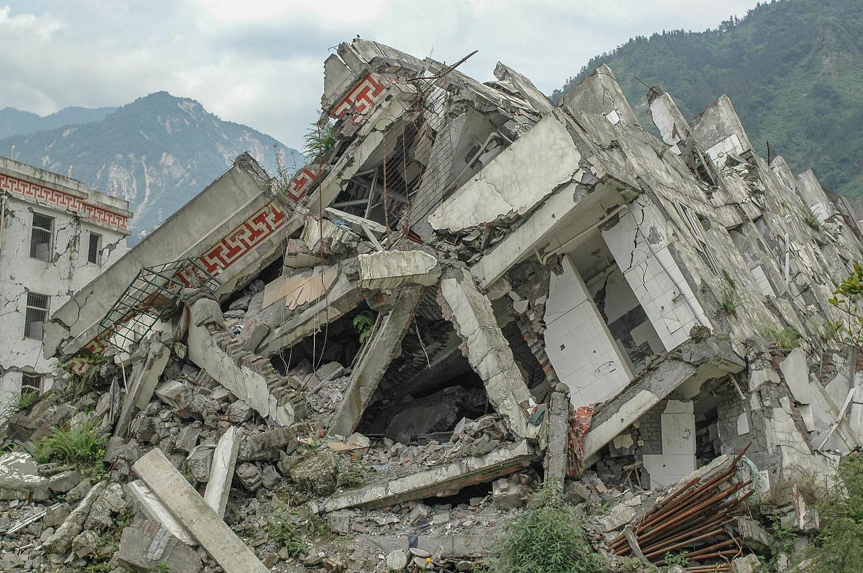
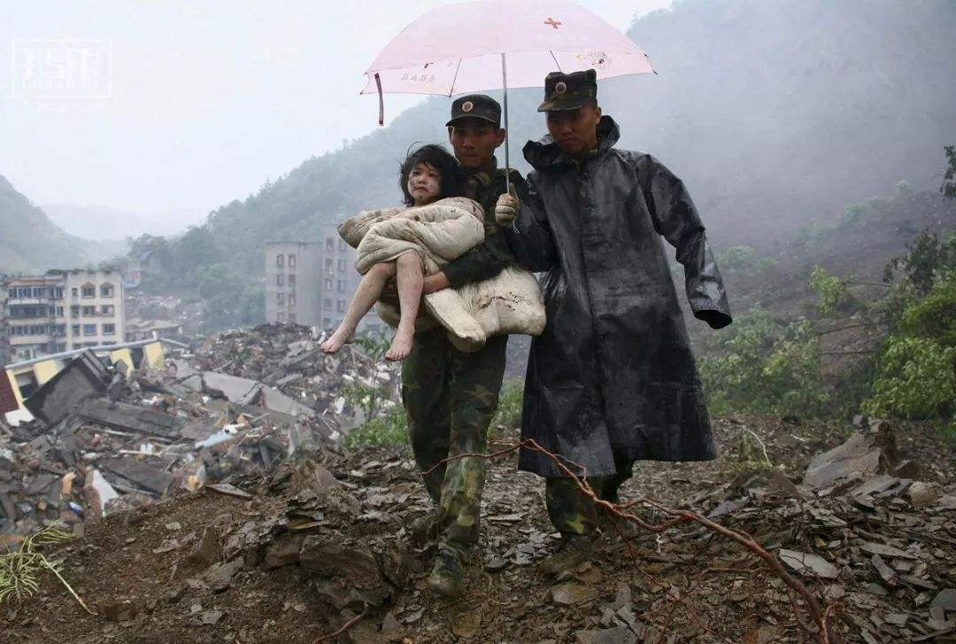

Slide 7
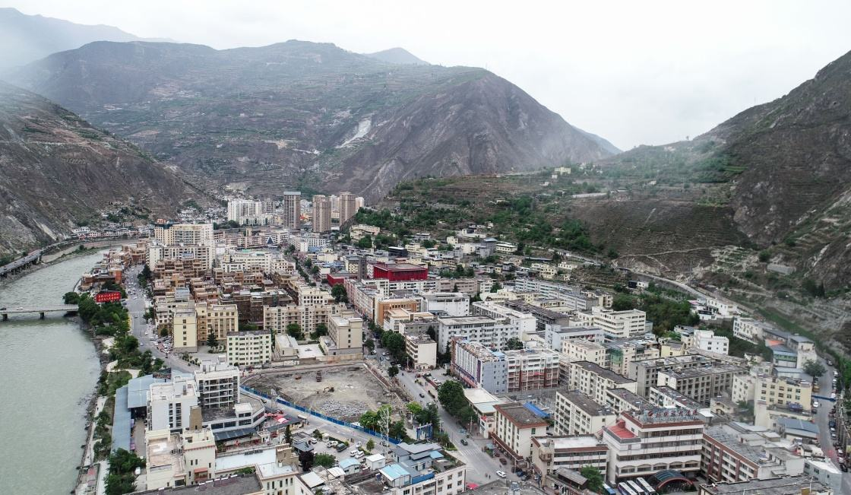
Wenchuan nowadays

Slide 8
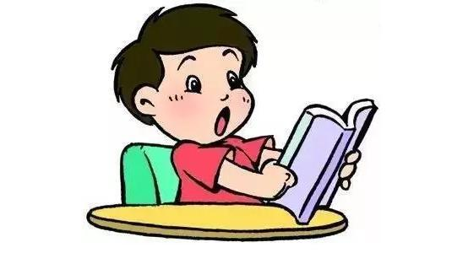
课 堂 学 习
Reading and vocabulary

Slide 9
Walking up
Work in pairs. Look at the pictures and ask and answer the questions.
1. Where are the people?
2 .What are they doing? Why?

Slide 10
Discussion
What should you do in an earthquake?

Slide 11
Fast reading
Listen and read. Then read the sentences. Decide if the following actions are right (√) or wrong (×).
When the earthquake started…
1 …I hid under a table.
2 …Sam sat on his desk.
3 …Alice ran out of the building.
4 …Peter and Helen stayed in their car.
5 …my family and I moved away from the beach.
√
×
×
√
√

Slide 12
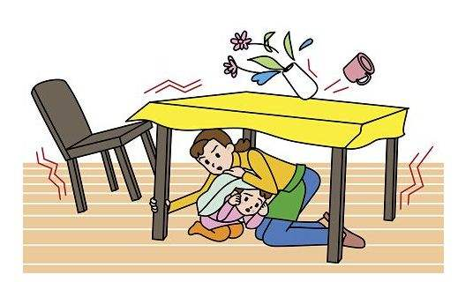
Careful reading
1. Read the passage and then complete the sentences according the pictures.
under
When an earthquake happens, hide ______ a table. Stay
away from _________ and heavy furniture. Don’t ______
out of high buildings.
windows
jump
Leave
______ the building quickly when the ground stops shaking.
But do not use the ______.
lift

Slide 13
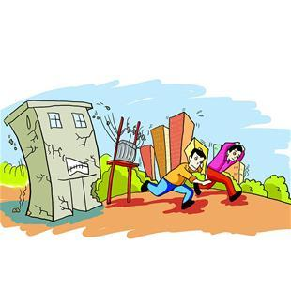
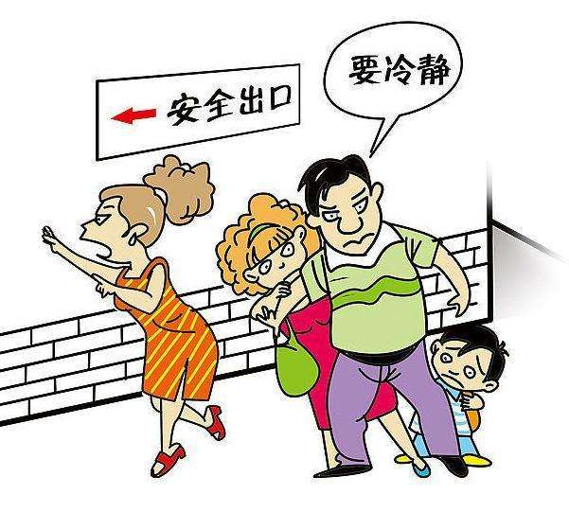
buildings
Move away from __________, because parts of a building
may fall on you.
calm
It is important to keep ________ during an earthquake. Try
to help others.

Slide 14
2. Read the phrases in the passage and put them into Chinese.
warn sb. about sth.
no idea
stay away from
keep clear of
stop doing sth.
keep calm
be careful of
run away from
in short
help do sth.
警告某人关于某事
不知道
远离……；与……保持距离
不和……接触
停止做某事
保持镇静
当心
逃离……
总之
帮忙做某事

Slide 15
Post -reading
1. Answer the questions. Use the words and expressions in
the box.
brave inside keep calm power lines street lights warn
1 What is difficult to do before an earthquake?
2 Where should you stay before the ground stops shaking?
It’s difficult to warn people before an earthquake.
We should stay inside.

Slide 16
3 What should you do when you are with other people?
4 What shouldn’t you stand near or under in the street?
We should keep calm and be brave.
We shouldn’t stand near power lines or under street lights in the street.

Slide 17
2. Retell the passage.
Do not jump out of …
Hide …Stay away from… Keep clear of…
Leave…, do not use…
Keep … Be…
Move away from…
Do not stand near…or under…
Stay away from…
Be careful of…
Run away from… move quickly to…
Inside
Outside

Slide 18
Language points

Slide 19
1. …so it’s difficult to warn people about them. ……所以很难给予人们预警。
warn动词，意为“敬告；告诫”。
(1) warn sb. about / of sth. 警告/告诫某人关于某事
His father warned him about his schoolwork.
他的爸爸警告过他注意学业。
(2) warn sb. (not) to do sth. 警告某人（不要）做某事
Our teacher warned us not to play football in the street.
我们的老师告诫过我们不要在大街上踢足球。
(3) warn sb. against (doing) sth. 警告某人不要做某事
The guide warned us against touching the plants.
导游告诫我们不要碰那些植物。

Slide 20
2．Inside在室内
inside在多种词性，其反义词是outside。
(1) inside作副词，意为“在里面；向室内”。
We looked inside, but saw nothing. 我们向里面看了看，但什么也没有看到。
(2) inside作名词，意为“里面；内部”。
We painted the inside of the house.
我们把房子的内部粉刷了一下。
(3) inside作形容词，意为“里面的；内部的”。
The inside walls of the house are clean.
房子的内墙很干净。
(4) inside作介词，意为“在……里面”。
Someone inside the room called for help.
屋子里有人在求救。

Slide 21
3. Keep calm, especially when you are with other people. 保持镇静，尤其是当身边还在其他人的时候。
keep此处作连系动词，意为“保持；留在”，后面常接形容词作表语。
keep calm 保持镇静 keep quiet 保持安静 keep healthy 保持健康
[拓展]
keep的其他常见用法：
keep (on) doing sth. 一直做某事
keep sb. doing sth. 使某人一直做某事
keep+宾语+形容词 使……保持某一状态
keep away from 远离；不接近
keep clear of 不和……接触

Slide 22
4. Be brave and helpful. 要勇敢；乐于助人。
(1) 本句是一个祈使句，以be动词原形开头。
Please be quiet. 请安静。
Be polite! 要讲礼貌。
(2) helpful形容词，意为“有用的；提供帮助的”。
Horses are very helpful animals. 也是非常有用的动物。
[拓展]
-ful是一个形容词后缀，可以跟在某些名词之后构成相应的形容词。
help + -ful =helpful
care + -ful = careful
thank + -ful = thankful
beauty + -ful = beautiful

Slide 23
Writing

Slide 24
1.Work in pairs. Do the following research.
Inside your school
Make a list of safe places and dangerous places at your school if an earthquake happens.
Note where the nearest stairs and doors to the outside of the school buildings are.
Outside your school
Make a list of places near your school. Note if they are safe or dangerous.
Note where the streets go, and where street lights and power lines are.

Slide 25
2.Complete the table.
Inside | Safe places | Dangerous places
Outside

Slide 26
3. Write some instructions about what to do in an earthquake.
Go out and meet on the playground.
Do not use the lift.
--- Stay away from the blackboard.
--- You must stay away from the blackboard. It could fall on you.
--- Don’t sit under the window.
--- You mustn’t under the window. It could break.
Now work in pairs. Check and share your instructions.

Slide 27
课 堂 达 标
I. 短语翻译
１、告诫某人关于某事 ２、远离
３、不和…… 接触 ４、 保持冷静
５、 从…… 离开 ６、当心；小心
７、逃离 ８、总之
９、不知道 10、在地震期间
11、停止做某事 12、路灯
13、电线 14、帮着做某事
warn sb. about…
stay away from
keep clear of
keep calm
move away from
be careful of
run away from
in short
no idea
during an earthquake
stop doing sth.
street light
power line
help (to) do sth.

Slide 28
II.单项填空
A
1. The policeman warned the man ______ after drinking.
A. not to drive B. to drive C. to not drive D. against drive
2. --- Can you tell me how to read the word?
--- Sure. And a dictionary may be ______ when you don’t know how to pronounce a word.
A. careful B. helpful C. thankful D. beautiful
3. Mike jumped into the river to save the boy alone. How ______ he was!
A. pleased B. dangerous C. smart D. brave
4. --- Tony, please ______ all the windows.
--- OK, Mr Zhang.
A. open B. opening C. opens D. to open
B
D
A

Slide 29
III. 根据句意及汉语提示完成句子
1. --- Where did you find your basketball?
--- ________（在下面）my bed.
2. Mr Brown told us a lot about ________（电力）yesterday afternoon.
3. Lily sat next to the ________（窗户）, reading a book.
4. Daming is not only friendly but also ________（提供帮助的）.
5. We must stay ________ （镇静的）when an earthquake happens.
Under
power
window
helpful
calm

Slide 30
IV.根据汉语意思完成句子，每空一词
1. 总之，我在北京玩得很开心。
______ ______, I had a very good time in Beijing.
2. 一位老要告诫我们在这么坏的天气不要爬山。
An old man ________ us ______ ______ ______ the mountain in such bad weather.
3. 当地震发生时，不要从高楼向外跳。
________ ________ out of high buildings when an earthquake _________.
4. 在山里，你们应该远离危险的地方。
You should ________ ________ ________ dangerous places when you are in the mountains.
In short
warned not to climb
Don’t jump happens
stay away from

Slide 31
5. 当你使用电梯时，不要接触电梯的门。
When you take a lift, keep ________ ________ the door of the lift.
6.她朝里面看，但什么也没看见。
She looked ______,but she saw______.
clear of
inside nothing

Slide 32
Homework
1. Read the passage.
2. Talk with your partner about what to do and what not to do in an earthquake.

Slide 33
Thank you !

