Slide 1
UNIT 12 What did you do last weekend?
Section B(2a—Self Check)
第 4 课 时

Slide 2
学 习 目 标
单词及短语：high, high school, ago, India, tent, put up, moon,
each other, surprise, get a surprise, snake, scared, move, shout to... start, jump, up and down, wake, wake...up, into, forest, ear
1
2
学会表述难忘的周末，并能够熟练运用所学句型，培养对生活的爱好。

Slide 3
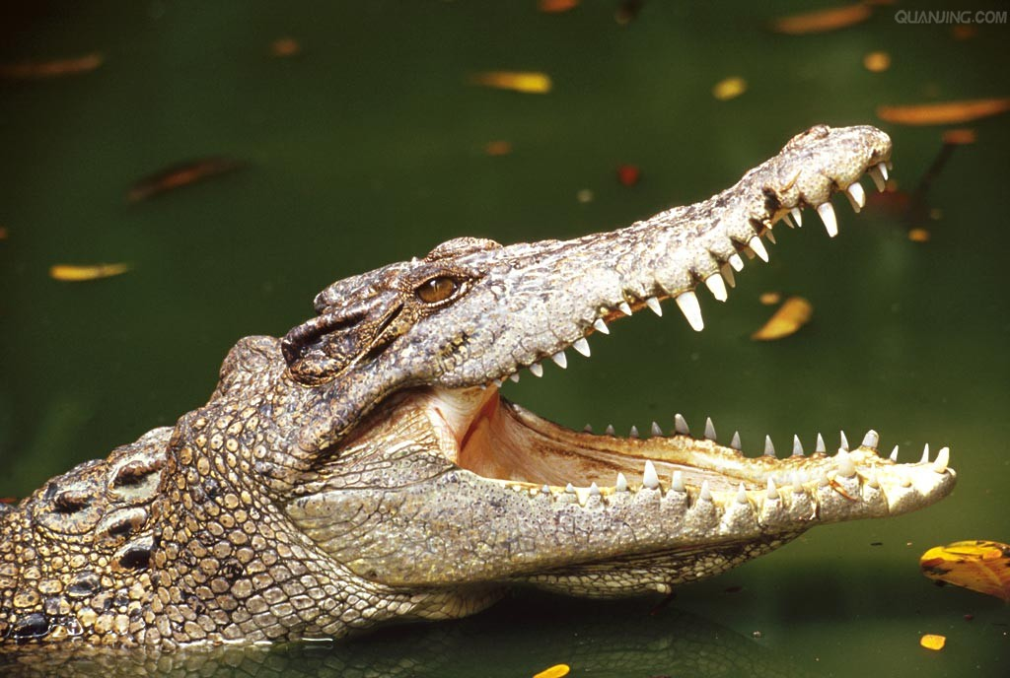
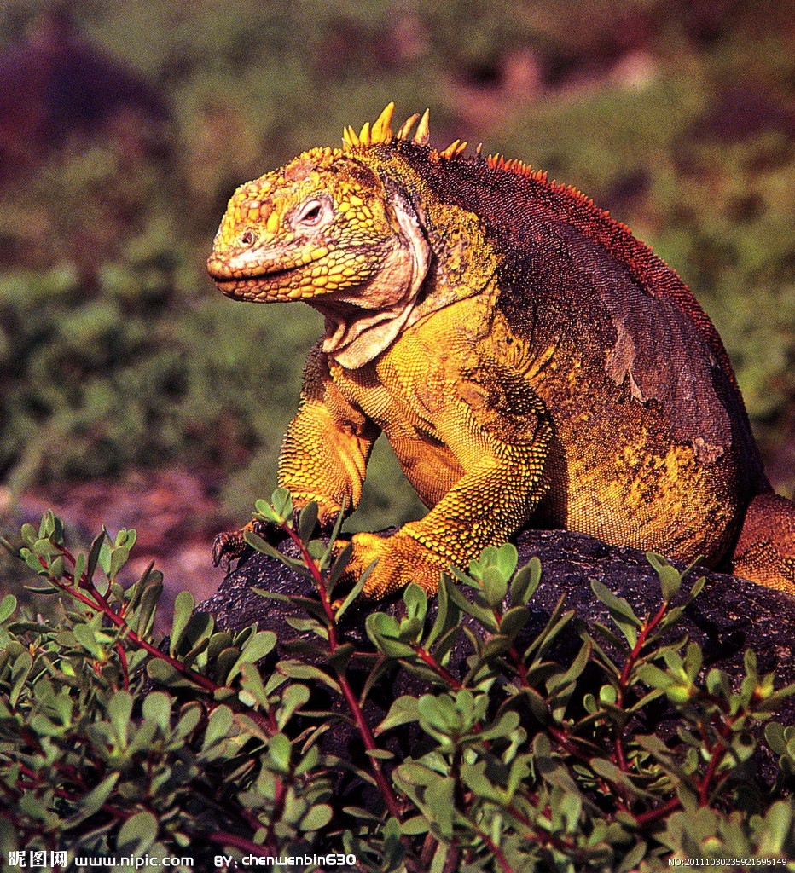
课 堂 导 入
2a
What kind of animals are people sometimes afraid of? Why? Make a list.
crocodile 鳄鱼
lizard 蜥蜴

Slide 4
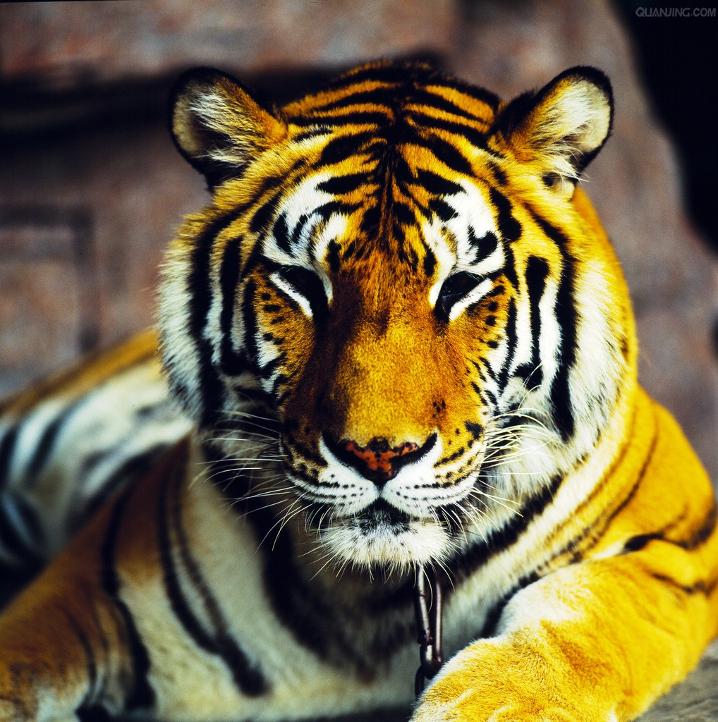
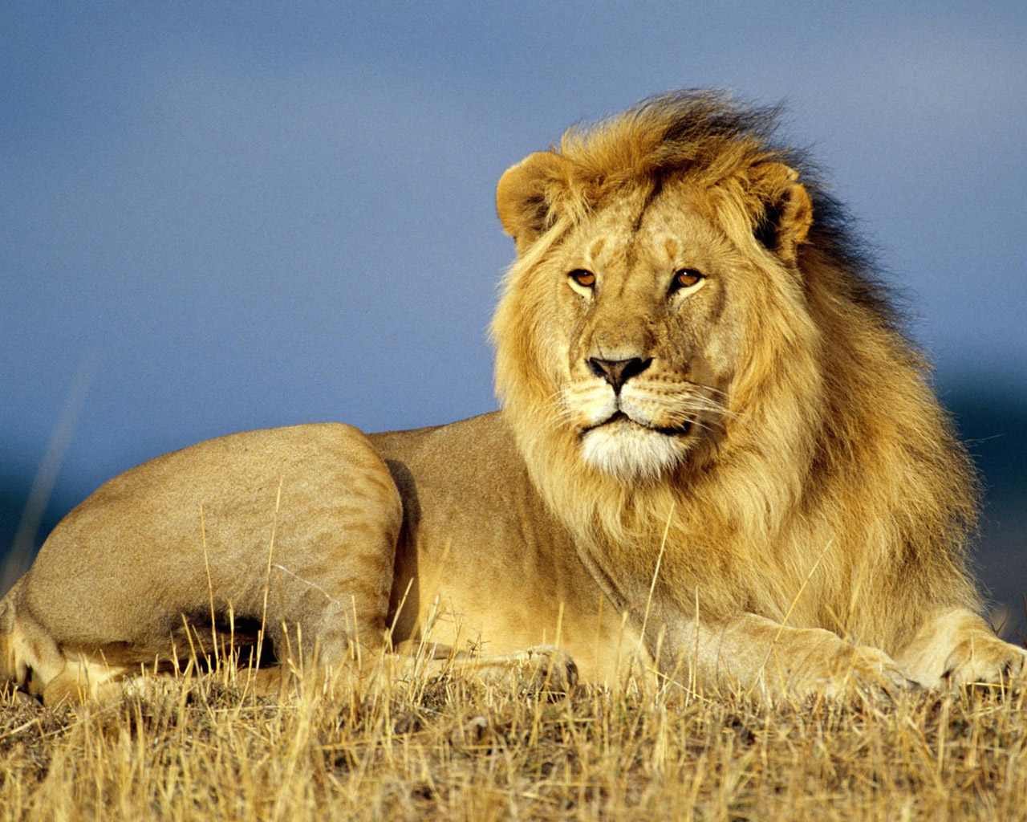
lion
狮子
tiger
老虎

Slide 5
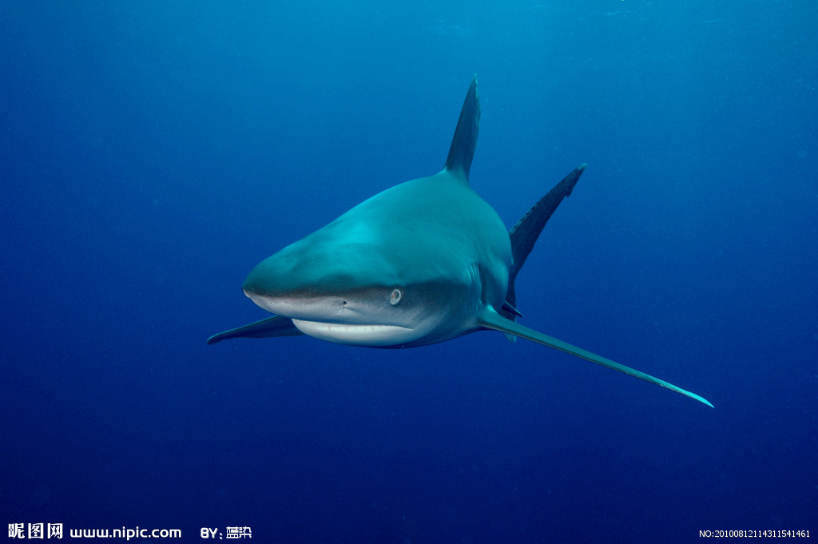
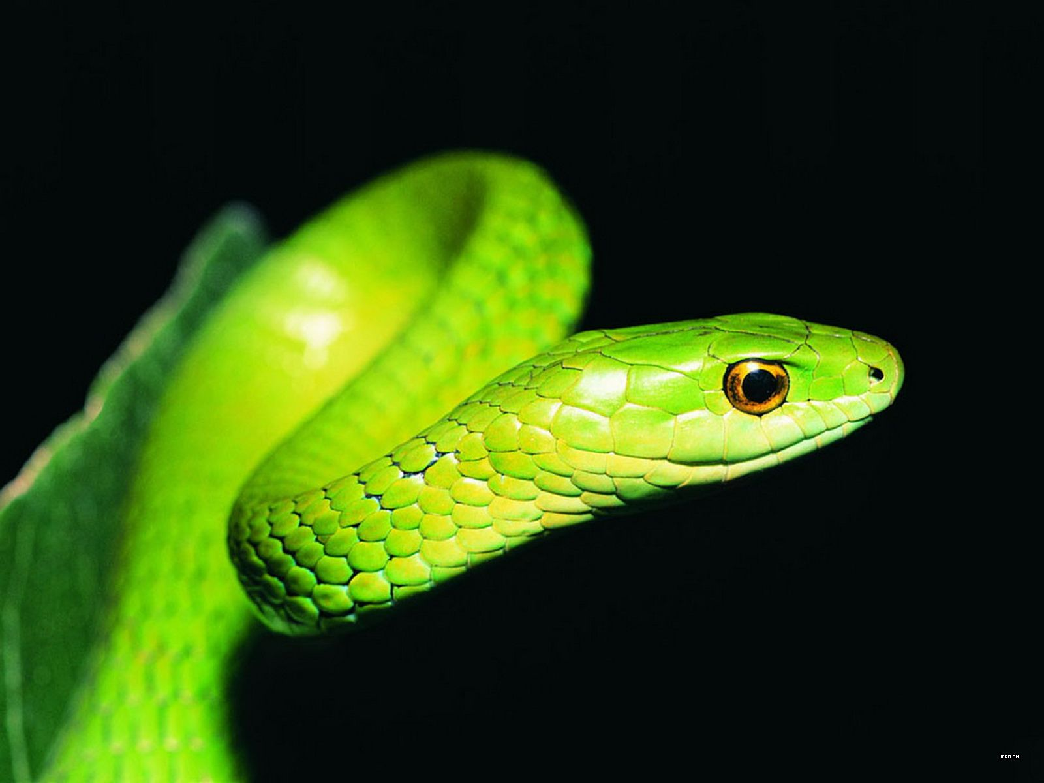
shark
鲨鱼
snake
蛇

Slide 6
I think people are afraid of tigers, lions and snakes because they’re scary and they may hurt people.

Slide 7
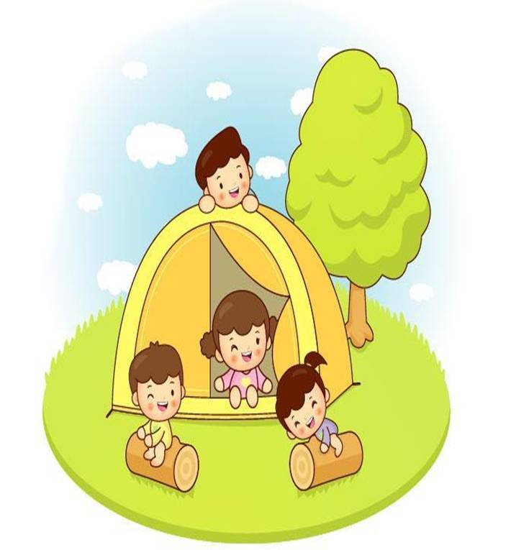
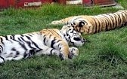
课 堂 达 标
2b
Listen to Lisa’s weekend. Tick (√) the right pictures.
two tigers sleeping near the fire
went camping in
a small village
made a fire to cook food on

Slide 8
Read about Lisa’s weekend and answer the questions.
How was Lisa’s weekend?
2. Where did Lisa and her family go last weekend?
3. How did Lisa feel when she saw the snake?
It was interesting but scary.
They went to a small village in India.
She was so scared that she couldn’t move.

Slide 9
4. What did Lisa and her sister do?
5. What did their parents do? Why did they do that?
6. What lesson did Lisa learn from the weekend?
They shouted to their parents.
Her father jumped up and down to scare the snake.
Don’t go near snakes./ Snakes can’t hear but they
can feel movements.

Slide 10
A Weekend to Remember
My sister finished high school two weeks ago.As a special gift, our parents took us to India. Last weekend was interesting but scary.
We went camping in a small village in India. First, we took a long bus ride to a lake in the country-side. There we put up our tents and made a fire to keep us warm and cook food on. On the first night, we just sat under the moon and told each other stories. But I was so tired that I went to sleep early.
The next morning, my sister and I got a terrible

Slide 11
surprise. When we looked out of our tent, we saw a big snake sleeping near the fire. I was so scared that I couldn't move. We shouted to our parents to let them know about the danger.My dad started to jumped up and down in their tent. This woke the snake up and it moved into the forest near the lake .My dad told me later that snakes don't have ears but can feel things moving. He also told me it was important not to go near a snake.This was a very useful lesson for me.

Slide 12
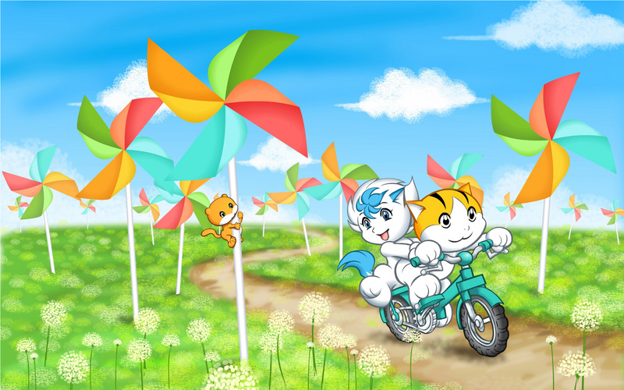
2c
Put the phrases in order according to the passage. Then
use them to retell the story.
____ snake went into the forest
____ put up our tests and cooked food
____ learned a useful lesson
____ saw a snake and shouted to parents for help
____ snakes can’t hear but can feel things moving
____ my dad jumped up and down in his tent
____ took a bus to a small village in India
____ told stories under the moon, then went to sleep
6
2
8
4
7
5
1
3

Slide 13
My sister finished high school two weeks ago. As a special gift, our parents （1）________ (take) us to India. Last weekend （2）_____(be)interesting but scary.
We went camping in a small village in India. First, we took a long bus ride to a lake in the countryside. There we put up our tents and （3 )________(make) a fire （4） __________(keep) us warm and cook food on. On the first night, we just （5）________(sit) under the moon and told each other stories. But I was so tired that I went to sleep early.
The next morning, my sister and I got a terrible surprise. When we looked out of our tent, we saw a big snake （6）_________(sleep) near the fire. I was so scared that I couldn’t move. We shouted to our parents to let them know about the danger. My dad started （7） ________(jump) up and down in their tent. This woke the snake up and it （8） ________(move) moved into the forest near the lake. My dad told me later that snakes （9）_____________(not have) ears but can feel things moving. He also told me it was important (10) ____________(not go) near a snake. This was a very
useful lesson for me．
took
was
made
to keep
sat
sleeping
to jump
moved
don’t have
not to go

Slide 14
Language points
As a special gift, our parents took us to India.
作为一份特殊的礼物， 我爸妈带着我们去了印度。
(1)此处介词as 表示“作为……; 当作……”，其后可以接职业，用途，特点等。用在句首时，这种短语的后面往往有逗号与语句的主体隔开。
As a student, I must work hard.
作为一名学生，我必须努力学习。
(2)本句中动词take 表示“带领”，take … to …则表示“带领某人去某处”。 On Sundays, the father would take his son to the park.
一到星期天，爸爸便会带他的儿子去公园

Slide 15
辨析： bring, take, carry, fetch
bring 意为“拿来，带来”，表示“拿到靠说话人近的地方”。
take 意为“拿走，带走”，表示“拿到远离说话人远的地方”。
carry 意为“扛，搬”，用力移动，没有方向性。
fetch 意为“去取，去拿”表示往返拿物,与get 同义。

Slide 16
2. There we put up tents and made a fire to keep us warm and cook food on. 在那里我们架起帐篷，生火取暖并做饭。
（1）动宾短语表达法：put up tents 搭建帐篷； make a fire 生火；keep us warm 使得我们暖和；cook food on the fire 在火上做饭
（2）本句的主体部分是we put up tents and made a fire, 后续的 to keep us warm and cook food on (it) 表达的是made a fire 的目的。句尾介词“on” 后有所省略，以避免重复。

Slide 17
3. On the first night, … 在头一天夜里，……
英语中表示一天中的时间分别采用at night (在夜里)、in the morning (在上午)、in the evening (在下午)等，但表示“在某一天上午、下午或晚上等”的特定时间，往往使用介词on。
On the early morning of November 20th, we got a special postcard. 在11月20号一大清早，我们收到了一张特殊的明信片。

Slide 18
4. But I was so tired that I went to sleep early. 但是我太累了，所以早早就睡着了。
英语中 “so …that …”，表示“太……以至于……”。
The game is so interesting that I don’t want to stop playing it.
这个游戏是如此有意思，以至于我都不想停下来。
【拓展】 “so…that…”可以和“too…to…”句式结构互换同义句。
Paul is ____lazy _____he doesn’t go to work.
Paul is ____lazy ____to work.
so
that
too
to

Slide 19
5. … we saw a big snake sleeping near the fire.
我们看见一条大蛇正在篝火附近睡觉。
My dad told me later that snakes … can feel things moving.
后来我爸告诉我蛇……能够感觉到东西的震动。
see sb./sth. doing sth. 意为“看见某人/某物正在做某事”，表示看到的动作正在发生；see sb./sth. do sth. 意为“看见某人/某物做某事”，表示看见了动作发生的全过程。
I saw them playing soccer just now.我刚才看见他们正在踢足球。
I saw him go into that room.我看见他进了那个房间。
【拓展】英语中表示感官的动词，例如see, hear, feel 等动词都有类似用法。

Slide 20
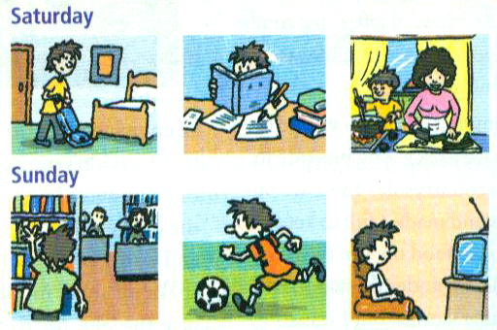
3a
Look at the pictures and complete the passage.

Slide 21
写作指导
先看所给的图画，明确它们所表示的动作。
2. 通读全文，理解短文大意。
理解每句话的意思，根据图片所表示 的动作及上下文的暗示来确定空格的意思。第一图画表示打扫房间，在短文中做了文字描述；第二图表示在做作业，应在第二空格处填；第三图显示“妈妈在做饭”，但本句主语是“I”，可推知空格处意为“帮助妈妈”；第四图显示他在图书馆里，可推知第三空格处应填“去了图书馆”；第四、五空格分别为踢足球和看电视。

Slide 22
I had a busy weekend. On Saturday morning,l _________________.
In the afternoon, I ___________________ . It was a little different.
On Saturdaynight, I stayed at home and________________ cook
dinner. On Sunday morning, I ___________________. I read a book about history. Then in the afternoon,I _______________ with my friends. On Sunday night,I ______________. I saw an interesting
talk show.
cleaned my room
did (my)
homework
helped my mom
went to the library
played soccer
watched TV

Slide 23
3b
Write about what you did last weekend.
写作指导
1.这是一篇介绍自己在周末两天所做的事情，因此用第一人称，用一般过去时态来写作。
2. 首先，应表述自己对周末的总体感受；
3. 然后，可以回想一下自己分别在周六上午、下午和 晚上分别做过什么事情；然后，再回想，在周日的 上午、下午、晚上分别做了什么事情。然后，将这些事情连在一起，形成一遍连贯的短文。
最后，还要再通读一遍短文，再重点看一下动词的 过去式是否正确。看句子是否通顺。

Slide 24
One possible version：
My last weekend was kind of busy. I washed my clothes on Saturday morning. In the afternoon,
I went to the library. I read a book there. I cooked dinner in the evening. On Sunday morning, I used the computer to have fun. On Sunday afternoon, I played ping-pong with my friends. In the evening, I did my homework.

Slide 25
Self Check
1 Complete the phrases. Then use some of them in the past forms to write a story.
kite
go
5. fly a ______
6. milk a _____
7. camp ____ the lake
8. study _____ a test
______ out with friends
______ for a walk
________ apples
______ photos
cow
go
by
pick/eat
for
take

Slide 26
2 Complete the conversation.
A: I had a school trip last week.
B: Really. ________________ (go)?
A: I visited the fire station.
B: _____________________ (go with)?
A: I went with my classmates.
B: _______________ (do)?
Where did you go
Who did you go with
What did you do
A: We watched the firefighters work. What an interesting job they have!
B: ______________________ (learn anything)?
A: Sure. We learned how to call the fire station and what to do when
there is a fire.
Did you learn anything

Slide 27
课 堂 达 标
一、选词填空。
ago tent surprise moon scared move start into
1. She went ____ the kitchen to cook some food.
2. The ______ circles (围绕) the earth every 28 days.
3. They came to visit China two days ____.
4. Do you know how to put up a ____?
into
moon
ago
tent

Slide 28
ago tent surprise moon scared move start into
surprise
5. She got a great _________ when she got the new phone.
6. My grandparents _______ to the countryside last year. They lived with my uncle in a village.
7. She _______ to learn English when she was ten.
8. She was really ______ to cross the rope way.
moved
started
scared

Slide 29
二、用所给词的适当形式填空。
1. She ______ (make) a fire _______( cook) some food yesterday.
2. They went ________(camp)in a small village in India.
4. When we_______( look) out of our tent, we ____(see) a big snake __________ (sleep) near the fire.
5. She got a great _________(surprise) when she heard the ___________ (surprise)
news.
7.She was greatly__________(surprise).
6.she was too_______(scare)________(move)when she ____(see) the _______(scare) snake.
made
to cook
camping
looked
saw
sleeping
surprise
surprising
surprised
scared
to move
saw
scary

Slide 30
Homework
1.Review the new words and expressions we’ve learned today.
2.Retell the passage in 2b.

Slide 31
Thank you !

