Slide 1
Unit 7 Chinese festivals
五年级

Slide 2
Try to get ★
★ Speak English as much as I can.
★ I can talk about Chinese festivals.
★ I can name the months of the year.
★ I know the sound of “th” .
★ Do some exercises(练习) well.
...

Slide 3
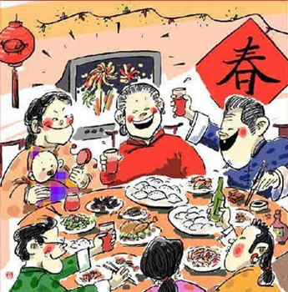
What comes into your mind?
Brainstorming
你想到了什么？(单词 词组 句子)
Spring Festival
January/February
get together with family
have a big dinner
eat dumplings
get red packet(拿红包), play fireworks(放烟火)…

Slide 4
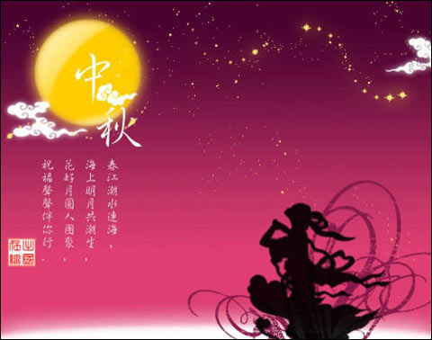
What comes into your mind?
你想到了什么？(单词 词组 句子)
Mid-Autumn Festival
September/October
look at the moon
eat moon cakes
get together with family

Slide 5
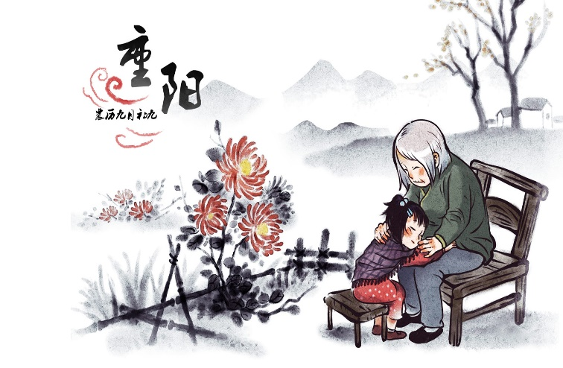
What comes into your mind?
你想到了什么？(单词 词组 句子)
Double Ninth Festival
October /November
visit parents and grandparents
climb mountains
eat rice cakes
come in autumn, a festival for old people…

Slide 6
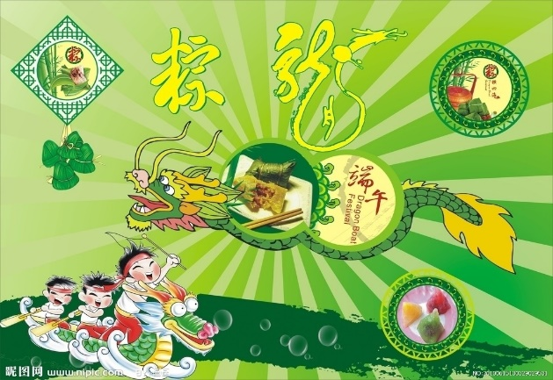
What comes into your mind?
你想到了什么？(单词 词组 句子)
Dragon Boat Festival
May/June
have dragon boat races
eat rice dumplings
remember the great poet Qu Yuan…

Slide 7
Let’s talk
If you want to know the details of a festival，what questions can you ask?（如果你想详细了解一个节日，可以提哪些问题?）
When’s the Dragon Boat Festival?
What do people do at this festival?
What do they eat at this festival?

Slide 8
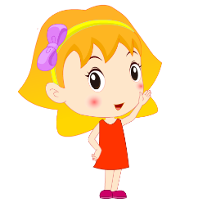
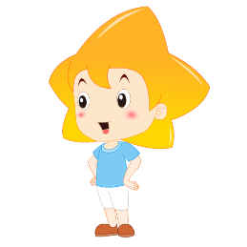
Mid-Autumn Festival
Spring Festival
September/October
look at the moon
eat moon cakes
January/February
get together with families
have a big dinner and eat dumplings
Dragon Boat Festival
May/June
have dragon boat races
eat rice dumplings
When’s the Spring Festival?
It's in...
What do people do at this festival?
They usually...
Double Ninth Festival
October/November
visit parents and grandparents
climb mountains
eat rice cakes
What do people eat at this festival?
They eat…

Slide 9
Let's do exercises
… is in … ……在……里。
Can you tell me the month of your birthday with this sentence?
你能用这个句型告诉我你生日的月份吗？
Do you know the months of four seasons?
你知道四个季节的月份吗？
Spring is in____________________________________.
Summer is in___________________________________.
Autumn is in____________________________________.
Winter is in____________________________________.
March, April and May
June, July and August
September, October and November
December, January and February

Slide 10
3.Dou you know the abbreviations of twelve months?
Jan.
Jul.
Feb.
Aug.
Mar.
Sept.
Apr.
Oct.
May
Nov.
Jun.
Dec.

Slide 11
4.Dou you know the pronunciation of th?
/θ/
mouth
thank
thin
think
They are thirsty.
These are my three thin cats.

Slide 12
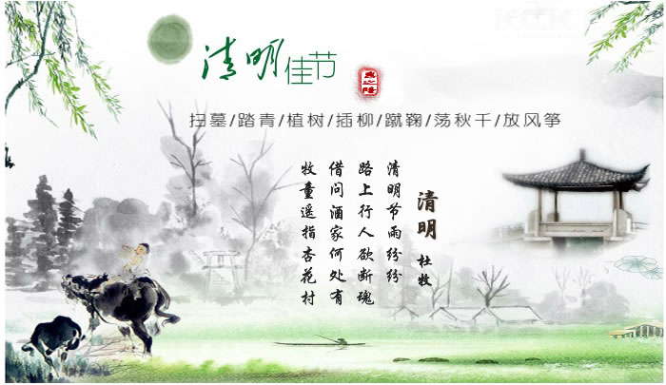
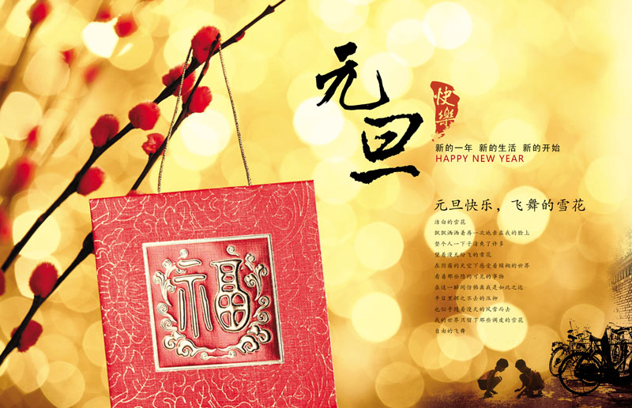
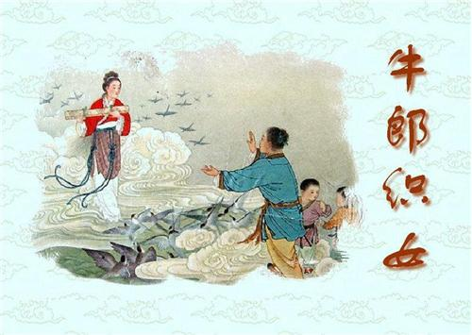
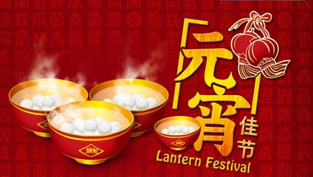
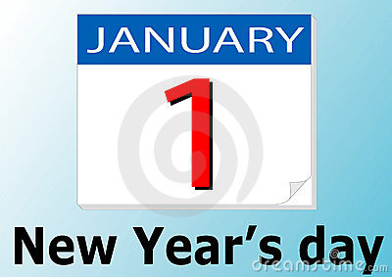
Tomb-sweeping Day
Double Seventh Festival

Slide 13
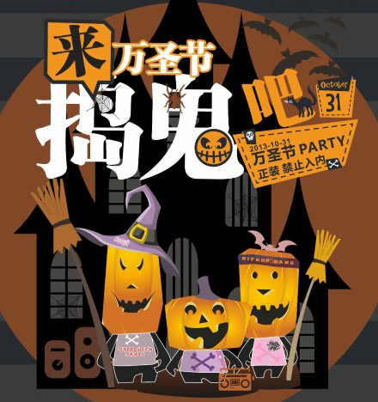
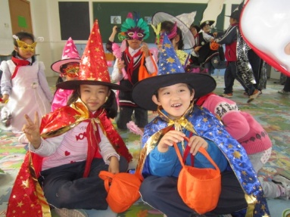
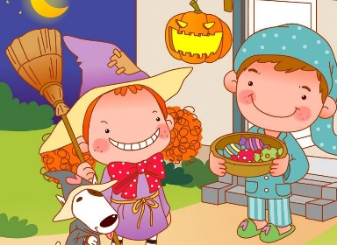
Let's watch.
I like Halloween.
It is on the thirty-first of October.
People usually dress up.
They knock on people’s doors
and shout “trick or treat” for sweets.
10月31日
打扮
敲
不给糖就捣乱

Slide 14
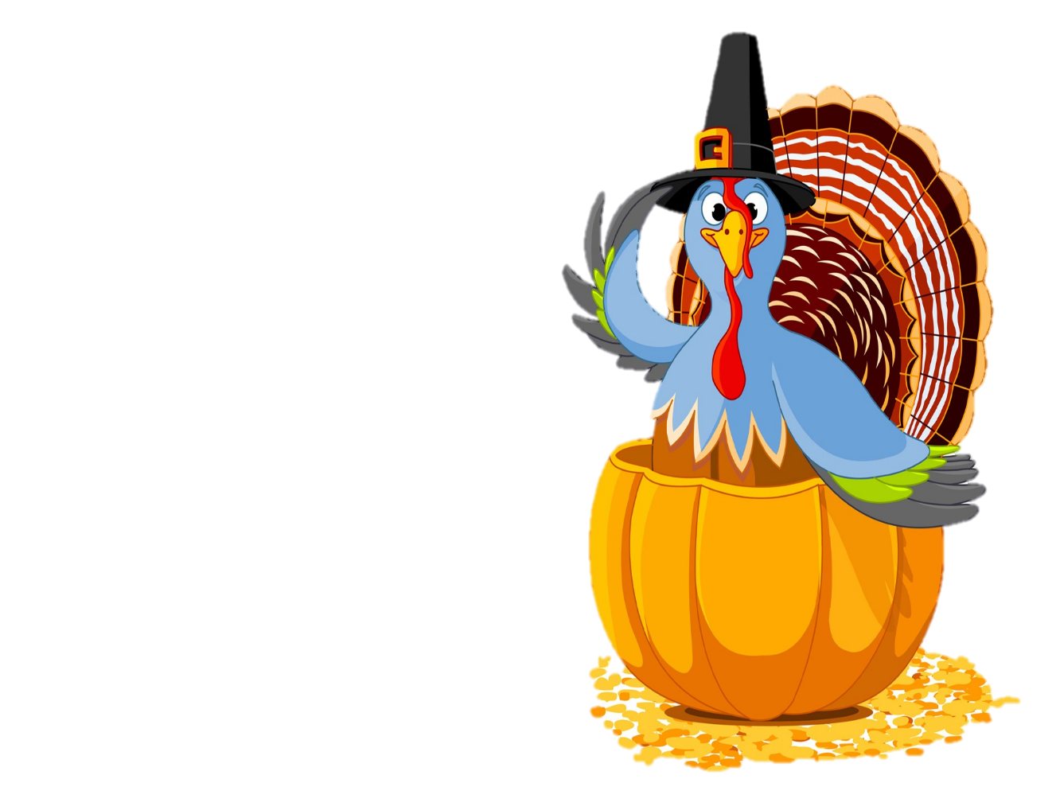
Important festivals

Slide 15
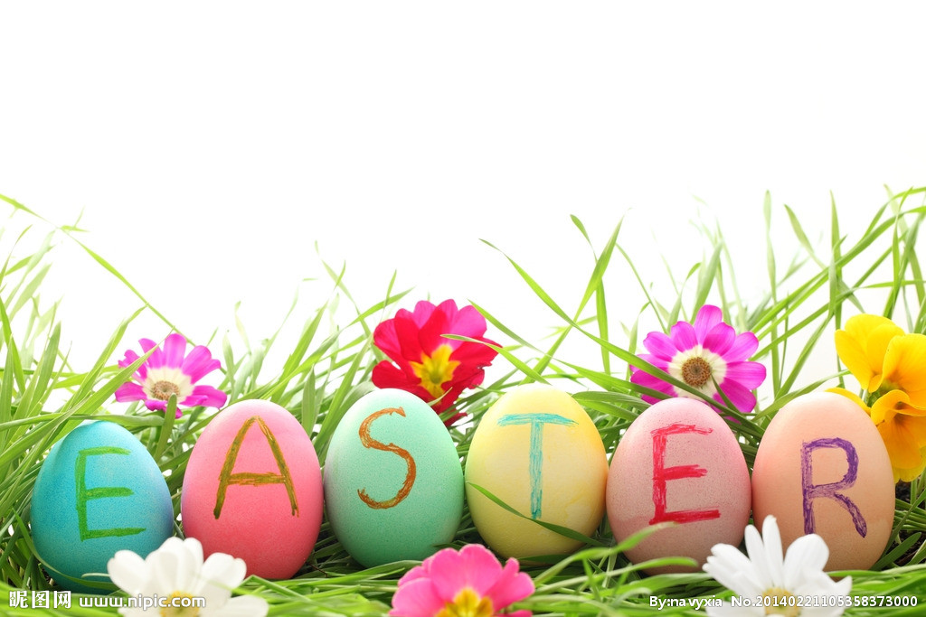
Easter Day
复活节

Slide 16
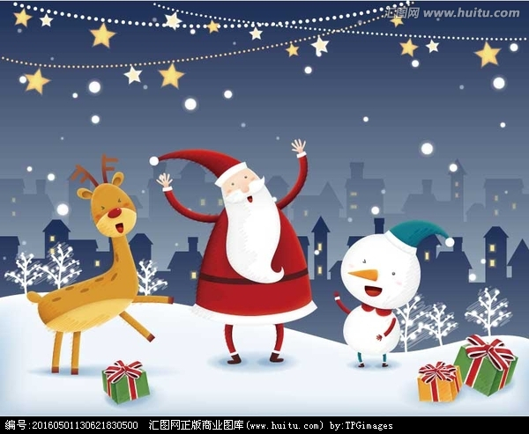
Christmas Day

Slide 17
Common festivals
Mother’s Day
Father’s Day
Children’s Day
April Fools’ Day
Earth Day
…

Slide 18
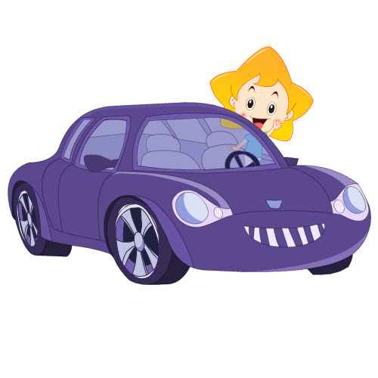
Love our culture, love every festival.

Slide 19
Let's share.
My favourite festival
My favourite festival is .
It is in/on .
At this festival, people usually
.
They eat .
I like this festival because
.

Slide 20
Homework
(1)Look for more information about
the holidays all of the world.
(搜集更多的全世界其他节日的信息。)
(2)Communicate with your friends and
relatives about your favourite festivals.
(和你的亲朋好友交流你最喜欢的节日。)

