Slide 1
Module 6 Unit 2
My grandma usually cooks.
二年级

Slide 2
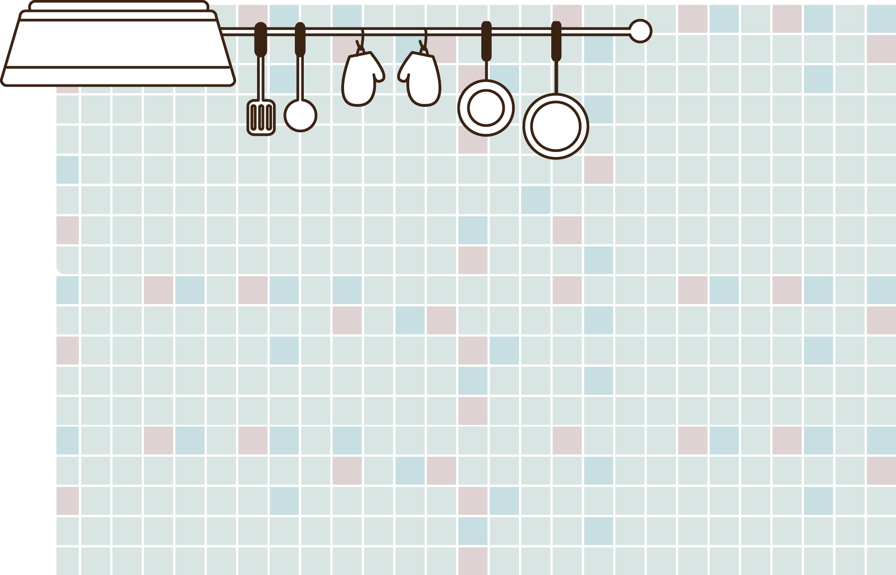
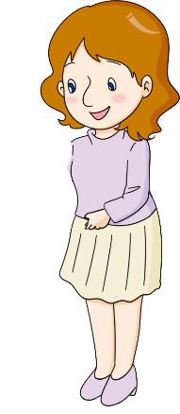
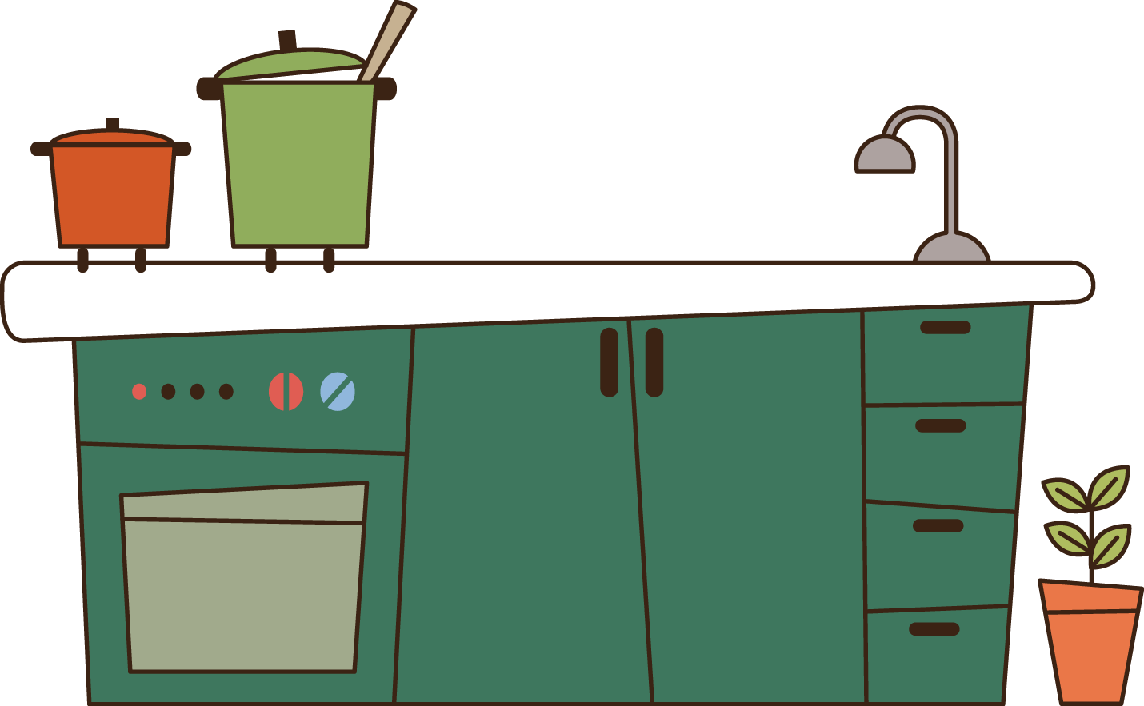
Listen point and say
My mother usually cooks. But today she’s not cooking. I'm cooking for her.

Slide 3
Listen and say
My grandma usually cooks. And she usually goes shopping. But today she isn’t doing these things.
Today I’m in the kitchen and I’m cooking. And my father is going shopping. Today is Grandma’s birthday!

Slide 4
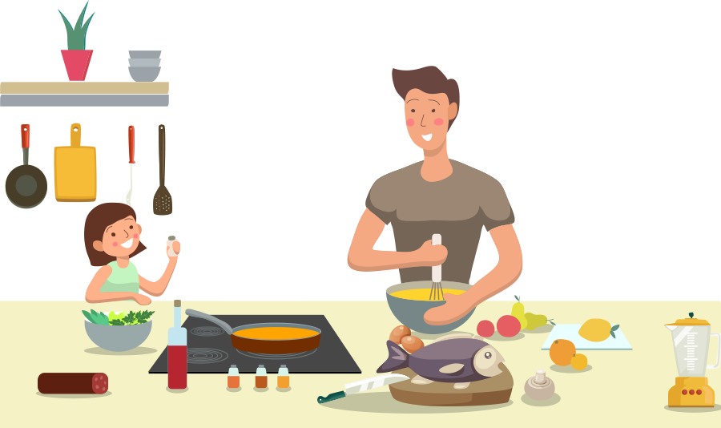
My father and I are cooking.

Slide 5
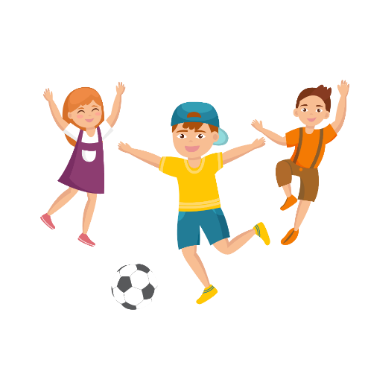
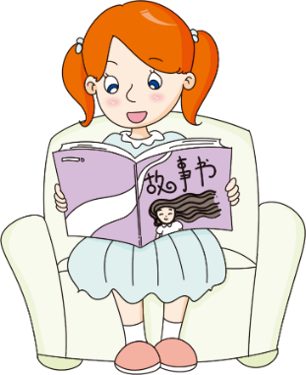
Look and say
He/she usually… Now, he/she usually…

Slide 6
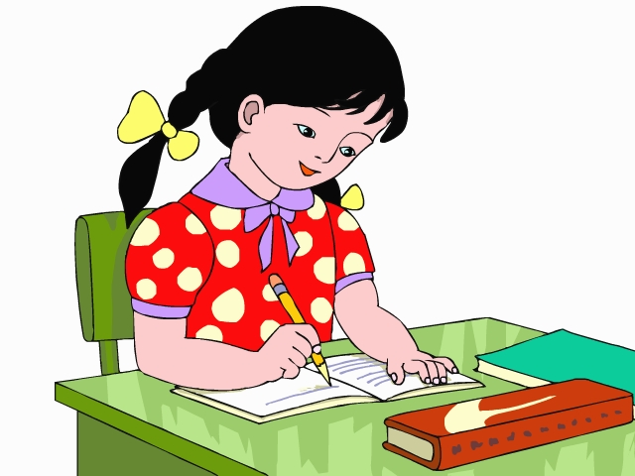
Usually

Slide 7
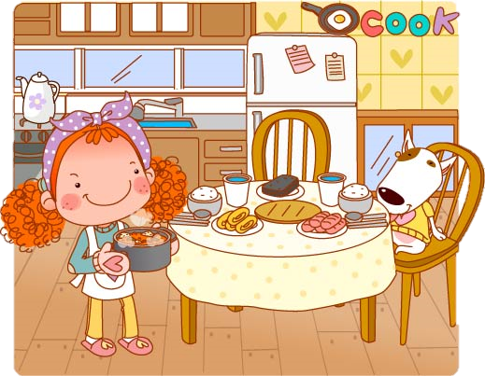
Now

Slide 8
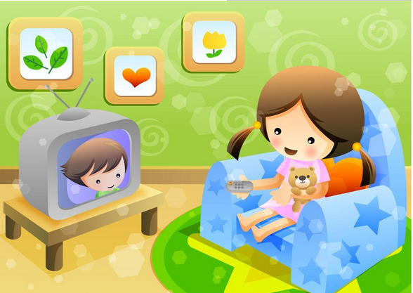
Usually

Slide 9
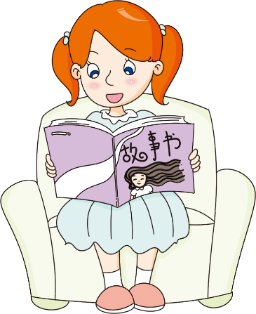
Now

Slide 10
Look and say
What do you usually do on Sundays?
What do you usually do?
I usually play all of the day.

Slide 11
And what are you doing now?
What are you doing now?
I’m reading a book
And learning to cook.

Slide 12
Find and say
Find five differences.
In picture A, he’s wearing a cap. In Picture B, he’s wearing…

Slide 13
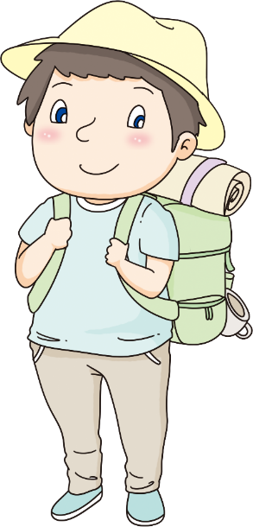
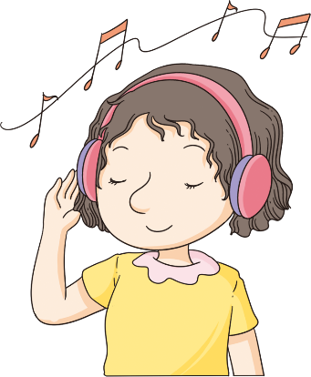
A
B

Slide 14
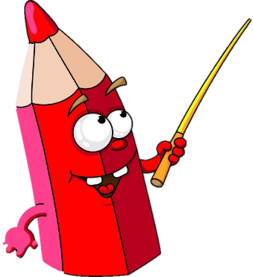
Do and say
Draw a picture and talk about yourself.

Slide 15
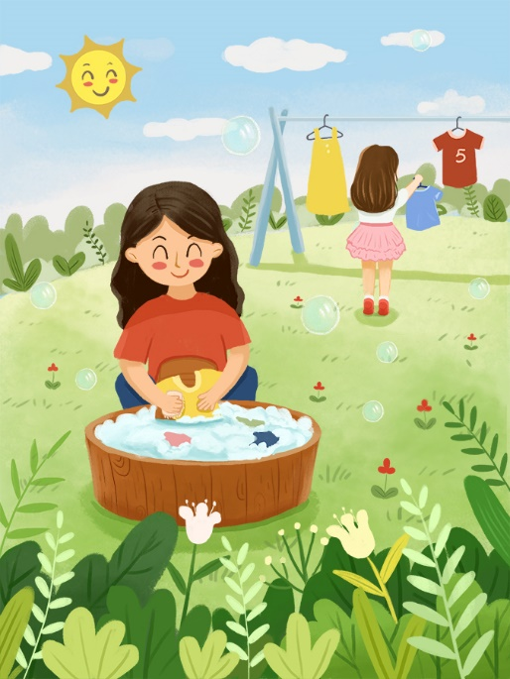
I usually watch TV on Sundays. But I’m helping my mother this Sunday.

Slide 16
Practice
1.先用I usually…But now I am…
2.再用He/She usually…But now he’s/she’s…

Slide 17
