Slide 1
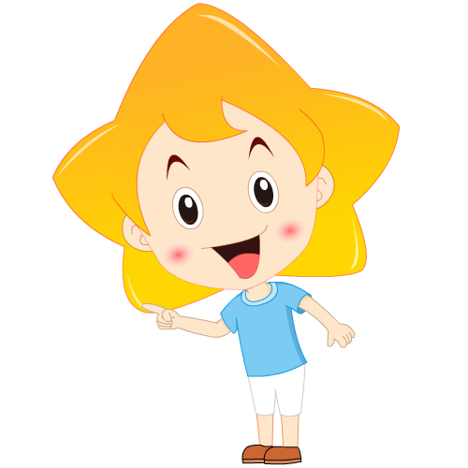
UNIT 7 How much are these socks?
Section B(2a—Self Check)
第 4 课 时

Slide 2
学 习 目 标
1
掌握重点单词、短语、句型。
clothes, sell, all, price…
at a/one’s great sale, at very good prices, skirts in purple…
Can I help you? Come and buy…
能够读懂购物广告并能自己写服装广告。
2

Slide 3
课 堂 导 入
Sing the song together!

Slide 4
Can you solve these maths problems?
ten
two +eight = _________.
four + nine = ________.
six + seven = __________.
eight + twelve = _________.
seven + eight = __________.
nine + fourteen = _________.
eleven + seven = _________.
ten +forty = ________.
eleven +eleven = _______.
three + thirty = _______.
twenty +seventy= __________.
thirteen
thirteen
twenty
fifteen
twenty-three
eighteen
fifty
twenty-two
thirty-three
ninety

Slide 5
课 堂 学 习
2a
How much do you think these things cost? Match each clothing item with a price.
1. a skirt ___ 3. socks ___ 5. shorts __
2. a sweater ___ 4. trousers ___ 6. shoes __
a. $3 c. $30 e. $22
b. $15 d. $20 f. $25

Slide 6
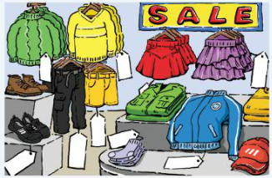
Look at the picture and title and answer:
1. What can you see in the picture?
2. Where are the clothes?
3. Do you know the store’s name?

Slide 7
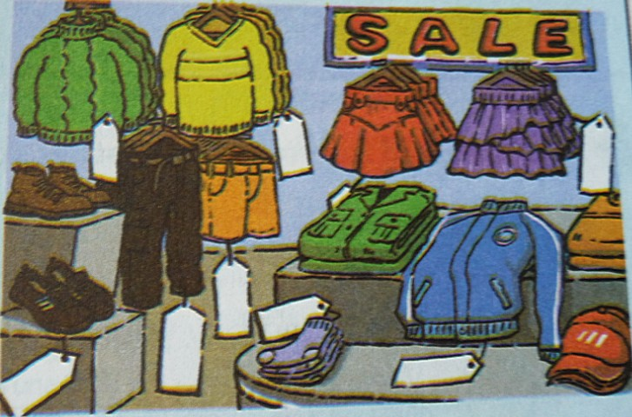
Read the ad and fill in the price tags.
2b
＄ 15
＄12
＄ 20
＄ 16
＄ 2
＄ 22
＄30
＄ 28

Slide 8
Fill in the blanks according to the passage:
Things | colors | price | for who
 | green yellow |  | / /
 | black
 | /
 | / |  | /
 |  |  | /
 | / |  | /
＄15
sweaters
＄ 12
trousers
＄ 22
for boys
shorts
＄ 16
for boys
skirts
purple
＄ 20
for girls
jackets
＄ 30
shoes
black
＄ 28
socks
＄2 / 3 pairs

Slide 9
Read the ad again. Answer the questions.
1. What can you buy at Mr. Cool’s Clothes Store?
2. How much are the sweaters?
3. How much are the trousers for boys?
We can buy sweaters, trousers, shorts, skirts, jackets, shoes and socks.
The green sweaters are 15 dollars and the yellow ones are 12 dollars.
They are 22 dollars.

Slide 10
4. How much are the purple skirts for girls?
5. If you want to buy six pairs of socks, how much do you have to pay?
6. What colors are the skirts for girls?
They are 20 dollars.
We have to pay 4 dollars for six pairs.
They are purple and red.

Slide 11
买，反义词是sell“卖”
衣服，是各种衣服的总称
大甩卖，大促销
出售；销售
以非常优惠的价格
所有的
紫色的裙子。in后接表示颜色的词，意为“……颜色的”

Slide 12
Imagine you work at Mr. Cool’s Clothes Store. Complete the conversation and practice it in a group.
2c

Slide 13
can
You: Hello, I help you?
Girl: Yes, please. I need a .
You: How about these purple ________?
Girl: Oh, I like this one. How _____ is it?
You: It’s only dollars.
Girl: Oh, good. I’ll it.
You: And what do you need?
Boy: Well, I need a pair of black ______ for school.
You: What about this pair? They are _____ twenty-eight _______.
Boy: Great. And do you have shorts, too?
You: Yes, our shorts are only __________ dollars.
Boy: OK. I’ll take the _______ and the ________.
skirt
一对；一双。一般用来修饰由两部分构成的单件事物，如trousers(裤子)，shoes(鞋)，glasses(眼镜)，jeans(牛仔裤)等。
skirts
much
20/twenty
take
shoes
only
dollars
16/sixteen
shoes
shorts

Slide 14
Look at the picture and try to write some sentences.
For example:
1. For girls, we have red skirts for only 25 yuan./You can buy red skirts for only 25 yuan.
2. We have trousers in black for only 20 yuan./ We sell black trousers for only 20 yuan./ Black trousers are only 20 yuan.
3. How much are our blue sweaters? Only 21 yuan.

Slide 15
3a
Look at the things in the picture. Fill in the blanks in the ad.
Huaxing Clothes Store
Do you like ?
We have for only yuan.
How much are your ?
Only yuan.
And red are yuan.
sweaters
sweaters
21
trousers
20
skirts
25
根据示例编写内容

Slide 16
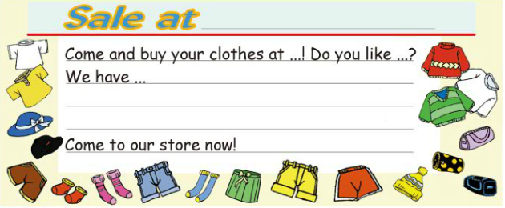
3b
Write an ad for your own clothes store.

Slide 17
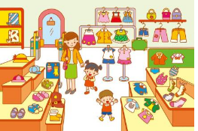
Group work
1. 小组讨论，设计一家服装店，包含服装店的名字、地址、衣服的价格等。
2. 为你们的服装店写一则广告。
3. 向班里同学展示你们的广告内容。

Slide 18
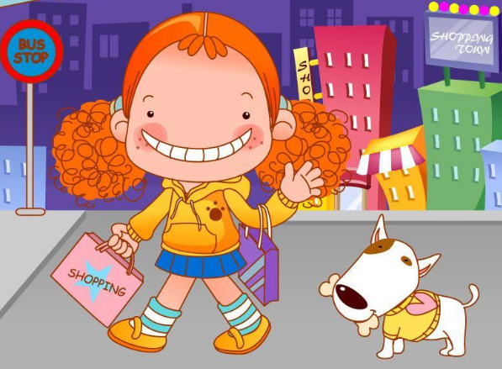
You can use the following expressions. Come and buy your clothes at our great sale.
We sell all our clothes at very good prices.
Come to … now!
Do you like…?
Do you need…?

Slide 19
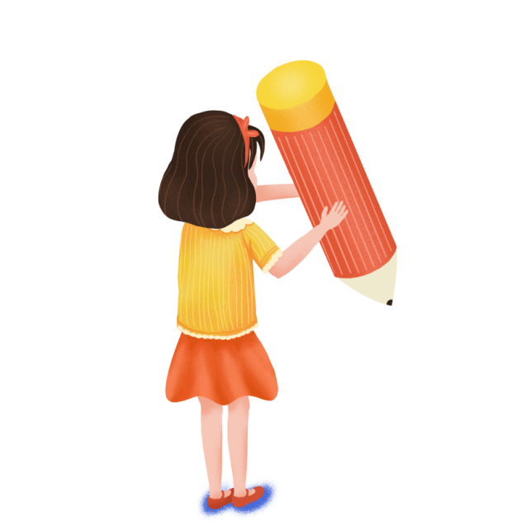
e.g. Sale at Little Bear’s Store
Come and buy your clothes at Little Bear’s Store! We have a big sale! Do you like hats, shorts or socks? We have these in all colors, and they’re all on sale! Do you need T-shirts, shoes or skirts? We have red T-shirts, black or white shoes, and brown skirts on sale. We have all the clothes you need. Come to our store now!

Slide 20
Self Check
1. Describe what these people are wearing today.
I: __________________________
My partner:_______________
My teacher:______________
a pair of white socks,

Slide 21
2. Put the sentences in order to make a conversation.
A. Thank you.
B. I’m sorry. We don’t sell bags.
C. You are welcome.
D. Here you are.
E. Yes, please. Do you sell bags?
F. OK. I’ll take them.
G. Can I help you?
H. I see. Hmm… those blue trousers are nice. How much are they?
I. They’re twenty-five dollars.

Slide 22
Check your answers.
G, E, B, H, I, F, D, A, C

Slide 23
Role-play the conversation with your partner.
G. Can I help you?
E. Yes, please. Do you sell bags?
B. I’m sorry. We don’t sell bags.
H. I see. Hmm … those blue trousers are nice. How much are they?
I. They’re twenty-five dollars.
F. OK. I’ll take them.
D. Here you are.
A. Thank you.
C. You’re welcome.

Slide 24
课 堂 达 标
I. 单项选择。
1. —The T-shirt is only ten dollars.
—I’ll ____ it.
A. take B. sale C. sell
2. — Can I help you? —_________.
A. I’m sorry. B. Thank you.
C. Yes, please. I want a skirt.

Slide 25
3. We have shoes _____ green, red and yellow
______ only 18 dollars.
A. at, to B. on, in C. in, for
4. How much ______ those red socks?
A. is B. are C. do

Slide 26
II.根据汉语提示完成句子。
1. 这是一件价格合理的T恤衫。
This is a T-shirt ______ a good ______.
2. 我们这儿不卖红色的袜子。
We don’t sell socks _____ ______ here.
at price
in red

Slide 27
3. 快来买，服装大减价了！
Come and ____ clothes ____ our great _____.
4. 我们这些短裤每件仅售15元。
We have shorts ____ _____ ________ dollars.
5. 这是给你的一条新裤子。
Here’s ____ ____ _____ _____ trousers for you.
buy at sale
for only 15
a pair of new

Slide 28
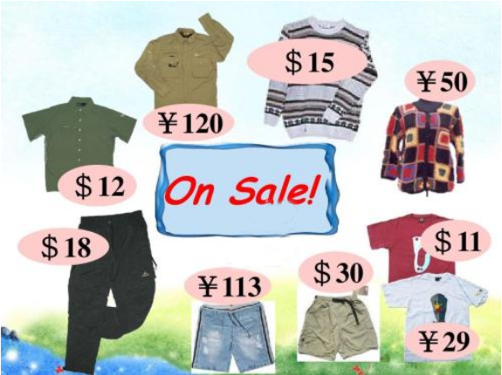
Homework
我的朋友约翰逊新开了一家服装店，请你根据图片为他写一则广告。广告内容应包括服装、颜色、价格、优惠活动等。50词左右。

Slide 29
Preview the new words and expressions in UNIT 8.

Slide 30
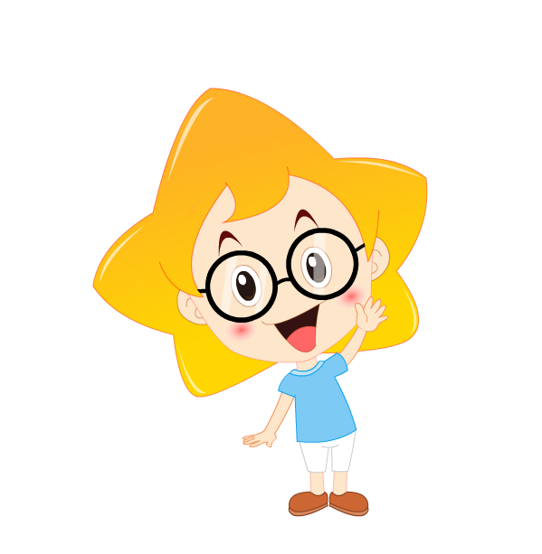
Thank you !

