Slide 1
UNIT 7 Will people have robots?
Section B(2a—2e)
第 4 课 时

Slide 2
学 习 目 标
学习本课时新单词和短语：human，servant，dangerous，already，factory，Japan, believe，disagree，even，agree, shape，fall，inside，possible，impossible，side,
over and over again, hundreds of, fall down, look for;
1
阅读课文“Do You Think You Will Have Your Own Robot?”；
了解未来机器人的发展。
2

Slide 3
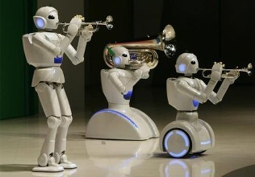
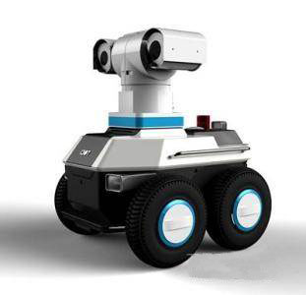
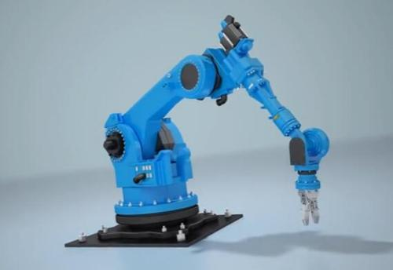
课 堂 导 入
Do you know something about robots ?

Slide 4
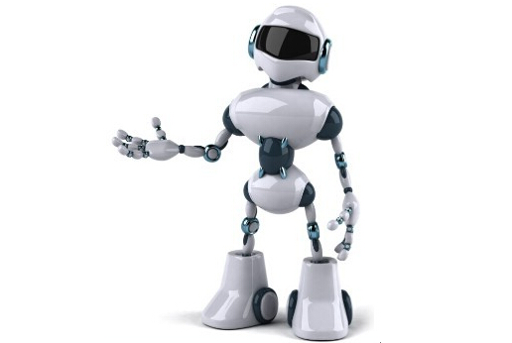
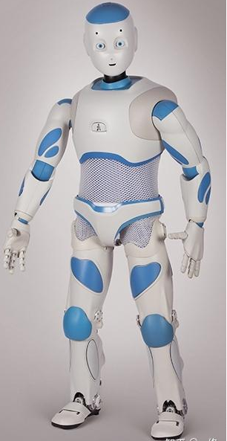
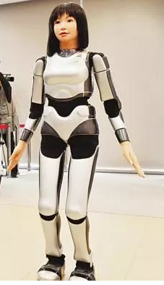
What do the robots look like?
humans
They look like ________.

Slide 5
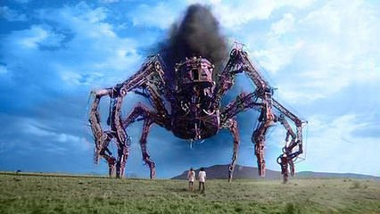
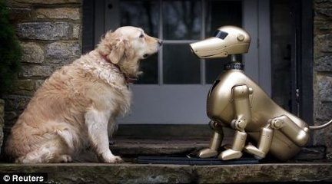
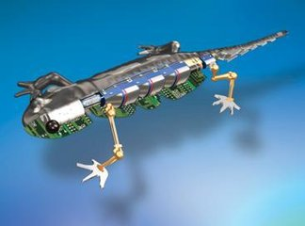
What do they look like ?
animals
They look like ________ .

Slide 6
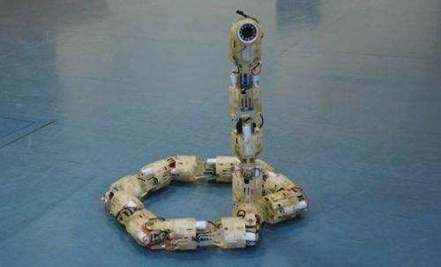
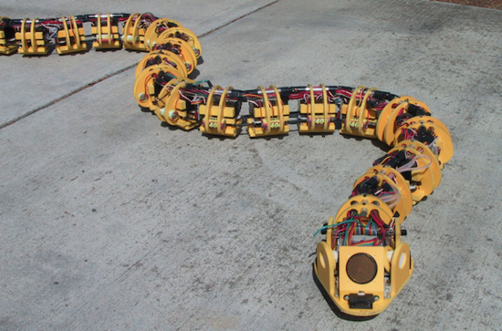
What do they look like ?
snakes
They look like_________.

Slide 7
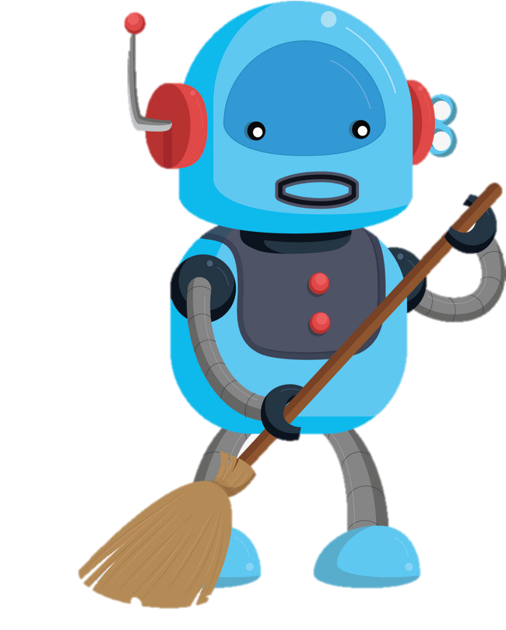
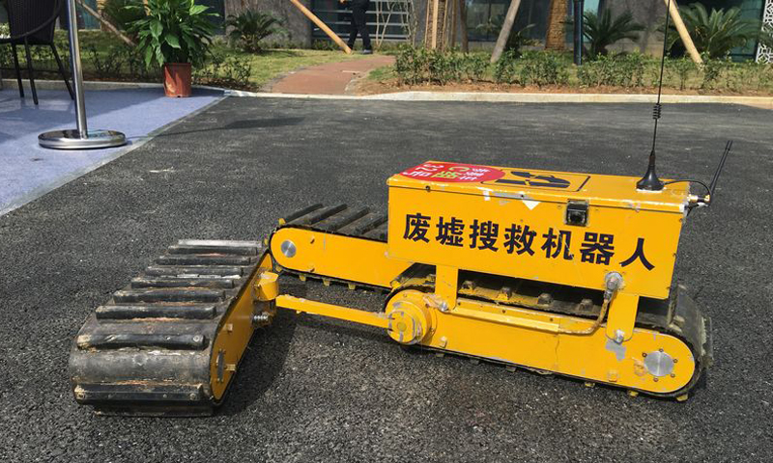
What can the robots do ?
help with the housework
look for people under buildings

Slide 8
课 堂 学 习
Tell your partner what you know about robots. What do they look like and what can they do?
2a
I think there will be more robots in the future.
Really? What do they look like?
I think they look like humans. They can do anything men can do.
Sounds interesting.

Slide 9
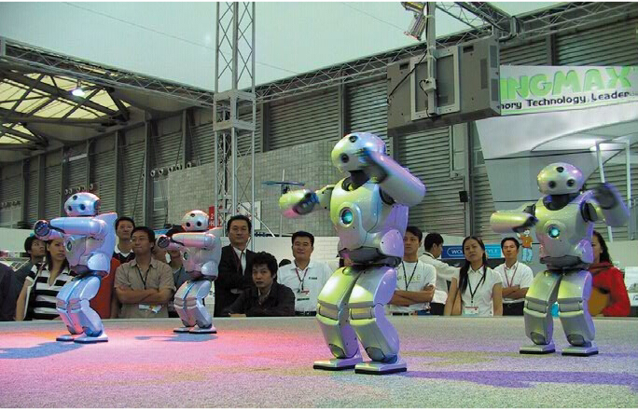
Per-reading
What is the article about?
The article is about _________.
A. how to make robots
B. what robots look like and what they can do

Slide 10
Fast reading
Read the article and match each paragraph with the question it discusses.
Will robots think like humans in the future?
Para. 1
What will robots be like in the
future?
Para. 2
What can robots do today?
Para. 3
Para. 4
What are robots like in movies?

Slide 11
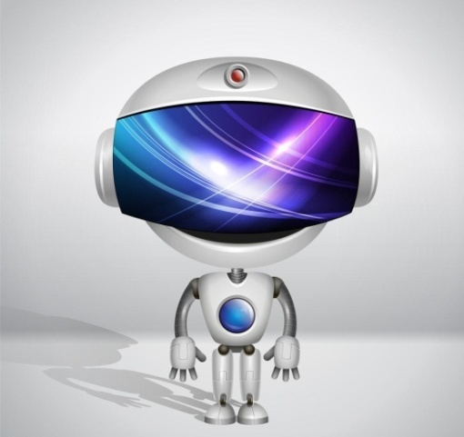
Careful reading
Read Paragraphs 1-2 and answer the questions.
1. What are the robots usually like in the movies?
They are usually like________________.
2.What can robots do?
They can help with the ___________.
They can do jobs like working in _______ or___________ places.
3)They can work in __________, like building _________.
human servants
housework
dirty
dangerous
factories
cars

Slide 12
Read Paragraph. 3 and complete the form.
Who do you agree with?
some scientists
other scientists
VS.
Some scientists think that in the future they will make robots more like humans. For example, some robots in Japan can ________and________. They think robots will even be able to ________like humans in 25 to 50 years.
Other scientists think it will be difficult to make robots _______like humans. For example, James White thinks robots will never be able to ______ ______and ______ where they are.
think
walk
dance
wake up
know
talk

Slide 13
Read Para. 4 and complete the diagram.
hundreds of years
How long: It may take ________________
Shapes: _________
_________
in India:_______
used for: ___________________
humans
Robots in the future
animals
snakes
help look for people…

Slide 14
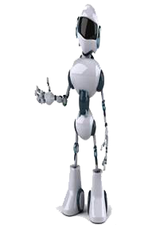
Summary
with housework
do jobs
In the movie
(Para1)
They can help _______________and _______in dirty or dangerous places.
In factories
(Para2)
build cars
They can help to _________ and _______________over and over again .
do simple jobs
In Japan
(Para3)
walk
dance
They can______ and _______.
In India
(Para4)
help look for people
They can __________________under the buildings.
In the future
talk like humans
They will be able to ______________ or _________________.
think like humans
Notes:
14

Slide 15
Listen to 2b and fill the blanks in this paragraph with words from the article.
dance
Some robots are very human-like. They can walk and ______ like people. Some scientists think that in the future they will _______ robots more like humans. This may not _________ in the near future, but at some point, robots will even be able to ______ like people. However, some scientists _________. James White believes that robots will not be able to do the ________ things as we can. For example, he thinks that robots will ______ be able to wake up and know where they are. Which side do you ________ with?
make
come true
talk
disagree
same
not
agree

Slide 16
Language points
（1）“There be +sb./sth.+doing sth.”意为“有某人/某物在做某事”。
Listen! There is a girl singing in the next room.听！隔壁房间有个女孩正在唱歌。
（2）“It is+形容词+（for sb.+）to do sth.”意为“（对某人来说）做某事是怎样的”。
①It is difficult for me to learn English well.学好英语对我而言很难。
②It is easy for me to get to school on time.按时到校对我而言很容易。
（3）hundreds of 意为“数以百计的”，后跟可数名词复数，不能和具体的数词连用。当hundred 表示具体数量时，用“基数词+hundred”来表示，不可以加s，也不可以和of 连用。例如：400是four hundred。
There are hundreds of books in our school library.我们学校的图书馆有数以百计的图书。
（4）seem意为“好像”，其后可跟形容词或动词不定式，还可用于“It seems/seemed that...”句型中。
他们似乎很高兴。
They seemed very happy.
=They seemed to be very happy.
=It seemed that they were very happy.

Slide 17
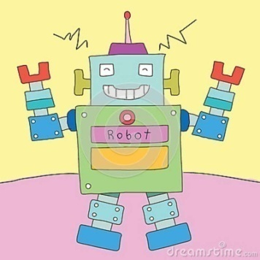
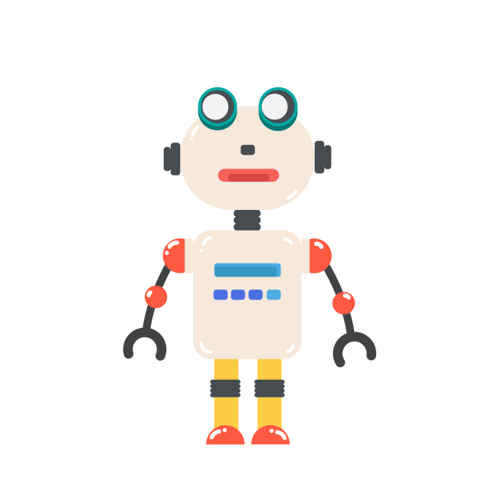
Group work
Let your imagination fly.
(放飞你的想像)
1. What kinds of animals might robots look like in
the future?
2. hat do you think these robots will be able to do?
Write your ideas and discuss them with your partner.
I think some future robots might look like ______. They will ______________...

Slide 18
课 堂 达 标
I.根据句意用所给词的适当形式填空。
1．Now many robots look like (human)．
2．Don't touch the machine. It's (danger)．
3．There are a lot of (factory) near my house.
4．He (believe) that he will win the game.
5．After doing my homework for hours，I felt (bore)．
humans
dangerous
factories
believes
bored

Slide 19
II.根据汉语提示完成句子
1．He works in actory I do（与……一样）.
2．To remember these new words,I read them__________________(多次，反复）.
3．You （看起来像） your father because you both have a big nose.
4．He is lazy.He never （帮助）the housework at home.
5． （数以百计的） students came to the playground to watch
the basketball match.
the same
as
over and over again
look like
helps with
Hundreds of

Slide 20
III.单项选择
1.There are some students basketball on the playground.
A. to play B. playing C. plays D. played
2. —Why does the coat look ____ small on him?
—Because he was ________ a big body.
A．so；such B．so；so C．such；such D．such；so
3. It is impossible for her ________ up to the top of the mountain.
A. climb B. climbs C. climbing D. to climb
4.If you see the film ，it will make you ____．
A．laugh B．to laugh C．laughing D．laughs
5.Did you know that the earth is home to ____ animals?
A．hundred B．hundreds
C．hundreds of D．hundred of

Slide 21
Homework
1.Retell the article in 2b.
2. Write a short passage about you own robots.

Slide 22
Thank you !

