Slide 1
UNIT 9 My favorite subject is science.
Section B(1a-1d)
第 3 课 时

Slide 2
学 习 目 标
学习本课时新单词： free, cool, Tuesday, Wednesday, Sunday, A.M. , P.M.
1
2
学会根据听力要求听取录音中的关键信息；
能够谈论喜欢和不喜欢的学科及其原因。
3

Slide 3
课 堂 导 入
How many days are there in a week?
What subjects do you have?
Monday Tuesday
Wednesday
Thursday
Friday
Saturday
Sunday
Chinese maths
English PE
music art
science
history
geography

Slide 4
Monday Tuesday
Wednesday
Thursday
Friday
Saturday
Sunday
What’s your favorite subject?
Geography.
Because it’s interesting/easy.
Why?
Chinese maths
English PE
music art
science history
geography
When do you have it?
I have it on Tuesday and Friday.

Slide 5
Monday Tuesday
Wednesday
Thursday
Friday
Saturday
Sunday
When do you have math?
I have it on Monday, Tuesday and Friday.
No. I don’t like it.
Do you like it?
Chinese maths
English PE
music art
science history
geography
Why not?
Because it’s boring/difficult.

Slide 6
课 堂 学 习
Because it’s interesting/easy.
Why?
反
义
词
Because it’s boring/difficult.
Why not?

Slide 7
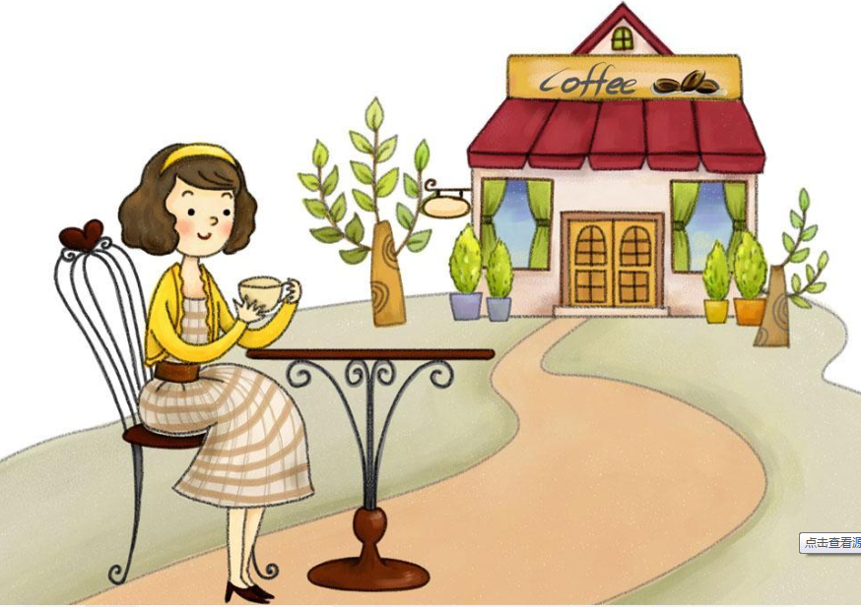
New Words
空闲的
free
busy 忙碌的

Slide 8
酷的，妙极的
cool

Slide 9
Match the words on the left with their opposites on the right.
1a
easy
interesting
fun
free
cool
boring
difficult
busy

Slide 10
Pre-listening
Read aloud the words three times.
Chinese math English PE
music art science
history geography

Slide 11
Listening
1b
Listen and check (√) the words you hear in 1a.
easy
interesting
fun
free
cool
boring
difficult
busy

Slide 12
关键信息
1c
Listen again. Circle the classes David talks about on this schedule.

Slide 13
Listening
1c
Listen again. Circle the classes David talks about on this schedule.
DECEMBER
Monday 25th | Tuesday 26th | Wednesday 27th
A.M. 08:00 science | A.M. 08:00 math | A.M. 08:00 Chinese
09:00 English | 09:00 math | 09:00 science
10:00 Chinese | 10:00 history | 10:00 math
11:00 P.E. | 11:00 science | 11:00 P.E.
P.M. 12:00 lunch | P.M. 12:00 lunch | P.M. 12:00 lunch
01:00 geography | 01:00 music | 01:00 English
02:00 art | 02:00 geography | 02:00 art

Slide 14
Thursday 28th | Friday 29th | Saturday 30th
A.M. 08:00 math | A.M. 08:00 Chinese | Soccer game
09:00 Chinese | 09:00 English
10:00 Chinese | 10:00 art
11:00 history | 11:00 P.E. | Sunday 31st
P.M. 12:00 lunch | P.M. 12:00 lunch | Bill’s birthday
01:00 geography | 01:00 math
02:00 English | 02:00 history

Slide 15
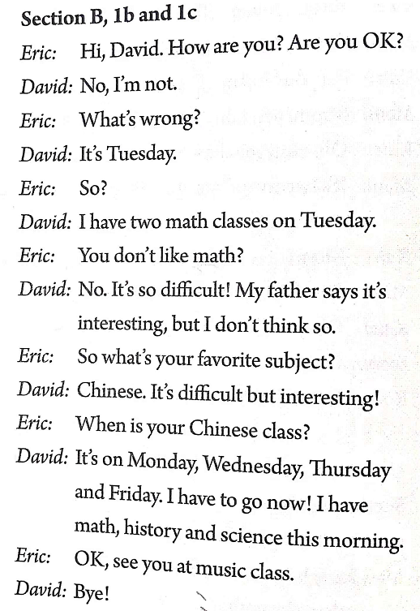
Listen again and read after it.
What’s your favorite subject?
When is your … class?

Slide 16
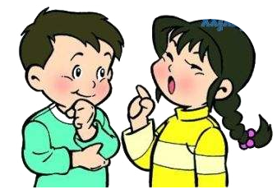
Pair work
Talk about David’s favorite subject with your partner. Then talk about your favorite subject.
1d
What’s David’s favorite subject?
Chinese.
Because it’s interesting.
Why does he like Chinese?
It’s on Monday, Wednesday , Thursday and Friday.
When is the class?

Slide 17
Pair work
What’s your favorite subject?
___________
Why do you like…?
Because it’s ___.
When is the class?
It’s on ____.

Slide 18
课 堂 达 标
根据句意和首字母提示完成单词
1. I’m busy now, but I’ll be f_____ tomorrow.
2. Davy looks c________ with a sunglasses(墨镜）.
3. Today is Monday, so tomorrow is T_________.
4. We don’t go to school on Saturday and S_________.
Thursday is after W_________.
I like geography. It’s d_________ but i___________.
ree
ool
uesday
unday
ednesday
ifficult
nteresting

Slide 19
Homework
1. Review the new words.
2. Preview 2b on page 53.

Slide 20
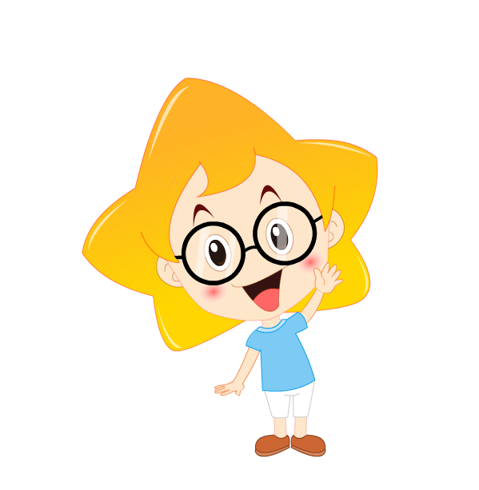
Thank you !

