Slide 1
Unit 3 第2课时
四年级

Slide 2
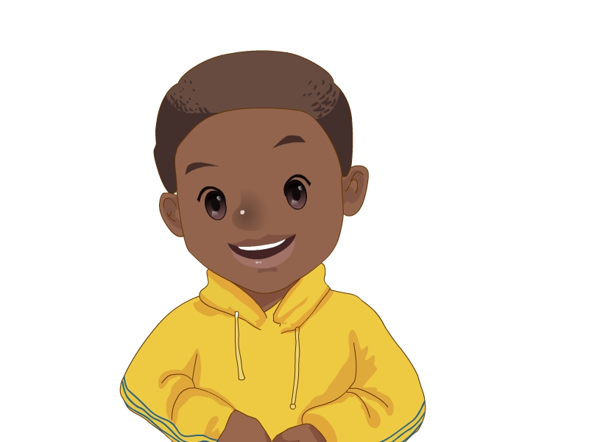
Who’s he? 他是谁？
His name is John.
他的名字是乔。

Slide 3
I have many friends .
Today is my birthday.
My friends will visit(拜访)me.
Let’s welcome them.

Slide 5
Tom

Slide 6
Tom
His name is Tom.

Slide 7
strong 强壮的
He’s tall and strong.
他又高又强壮。
Tom

Slide 8
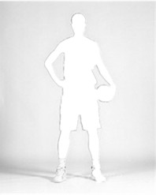
I have a good friend.
He’s tall and strong.
强壮的
Who is he?

Slide 9
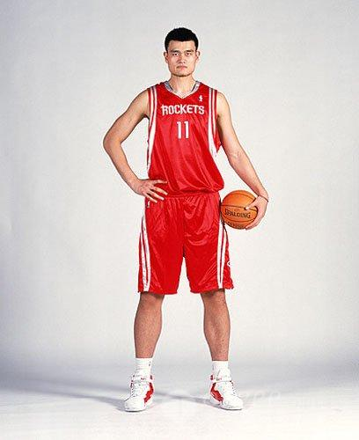
Who is he?
His name is Yao Ming

Slide 11
Li lin
His name is ____.
Li lin

Slide 12
He’s short and thin.
他又矮又瘦。

Slide 13
Who is he ?
His name is He Jiong.
He is short and thin.
.

Slide 14
He’s tall and strong.
他又高又强壮。
Tom
He’s short and thin.
他又矮又瘦。

Slide 16
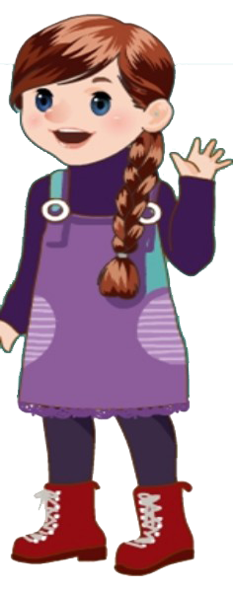
Who’s she
__________? 她是谁？
Her name is Lily
____ ________. 她的名字是莉莉。
friendly
友好的
= friend + ly

Slide 17
Who’s she
____________?
Her name is Sarah.
friendly
友好的
= friend + ly
Friendly friends,friends are friendly.

Slide 18
friend---- friendly
朋友 友好的
love ----lovely
爱 可爱的

Slide 19
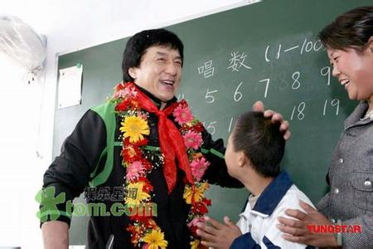
She’s friendly.
He’s friendly.
They’re friendly.

Slide 21
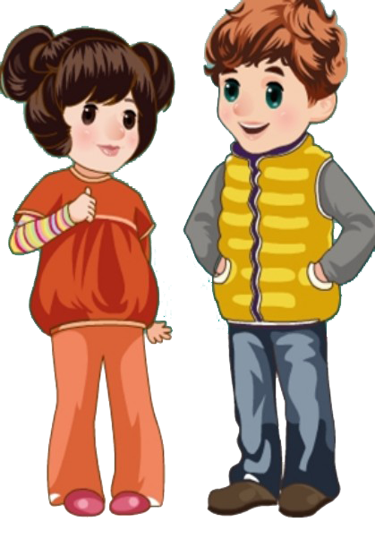
Zhao Chen
Lu Yao
Who’s he / she ?
His / Her name is….

Slide 22
quiet 安静的；文静的
Be quiet!
保持安静！
She is quiet.
她是文静的。

Slide 23
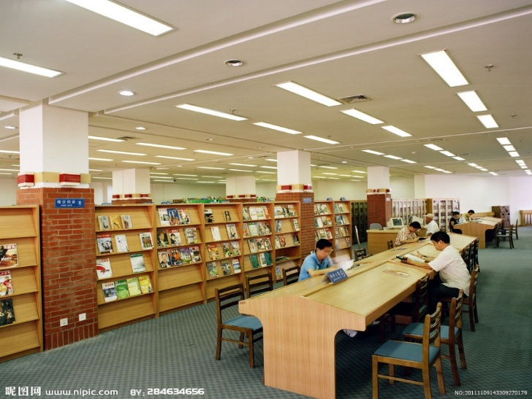
quiet 安静的 ；
文静的
She’s quiet.
她是文静的。
He’s quiet.
他是文静的。

Slide 25
quiet
tall and strong
friendly
short and thin

Slide 26
Lu Yao
Zhao Chen
quiet
Tom
Who’s he / she?
His / Her name is…
He’s / She’s…
tall and strong
Li Lin
Lily
friendly
short and thin

Slide 27
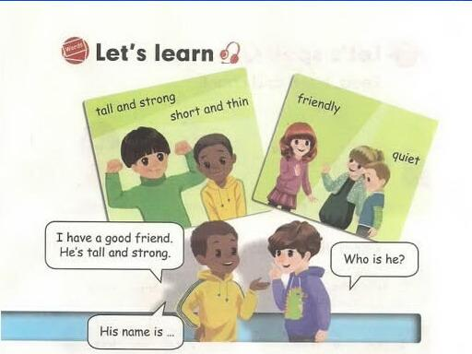
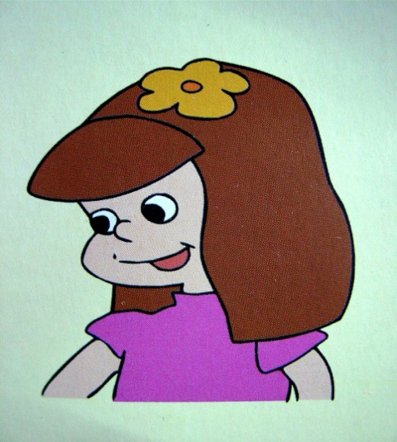
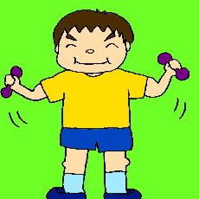
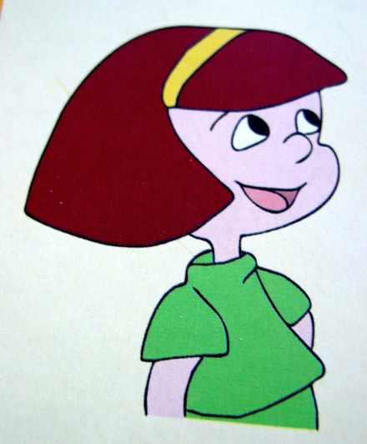
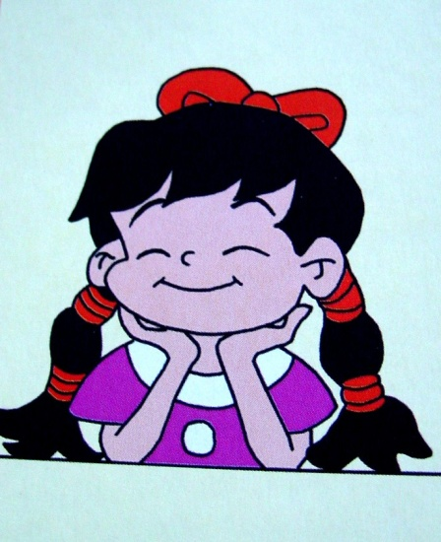
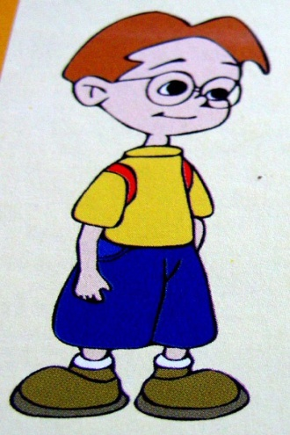
高，强壮
矮，瘦
朋友 安静
我有一个好朋友。他很高也很强壮。
BaiLing
LiMing
LiuYing
他的名字叫…
他是谁？
ChenJie
WuYifan

Slide 28
she 她
he 他
her她的
his 他的
her name....
his name...
She is =she's 她是
He is = He's 他是

Slide 29
读一读，比较一下
Who’s he? 他是谁？
His name is….他的名字是…
Who’s she? 她是谁？
Her name is…. 她的名字是…

Slide 30
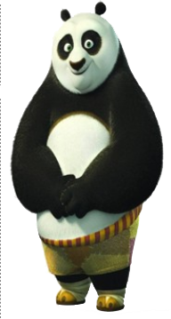
Who is he/she?
She is quiet. She has long hair. Who is she?
She has short hair. She is nice. Who is she?
She is thin. She has two big eyes. Who is she?
He is strong. He has a big mouth. Who is he?

Slide 31
Write and talk about your friends.
(写一写，并讨论一下你的朋友)
My friend
I have a good friend.
Her / His name is
She’s / He’s
She’s / He’s

Slide 32
小结
tall -- short strong -- thin
friendly quiet
I have a good friend.
He\She is …
His\Her name is …

Slide 33
A life without a friend is a life without a sun.
人生在世无朋友，犹如生活无太阳。
A friend in need is a friend indeed.
共患难的朋友才是真朋友。
A life without a friend is a life without a sun.
A life without a friend is a life without a sun.
人生在世无朋友，犹如生活无太阳。
人生在世无朋友，犹如生活无太阳。

Slide 34
Home work
1.完成抄写本。
2.完成作业本。

