Slide 1
Module 5 Unit 2
I wore warm clothes.
四年级(上)

Slide 2
Warm-up
She painted a picture.
She watched TV.
She played the flute.
She played with me.
He listened to music.
He played football.
He helped his mother.
There were sweets for all.

Slide 3
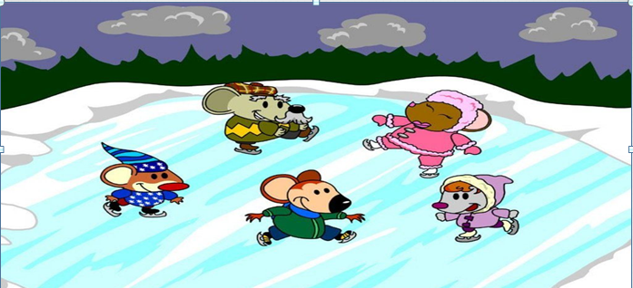
Presentation
skate
ice–skating
滑冰

Slide 4
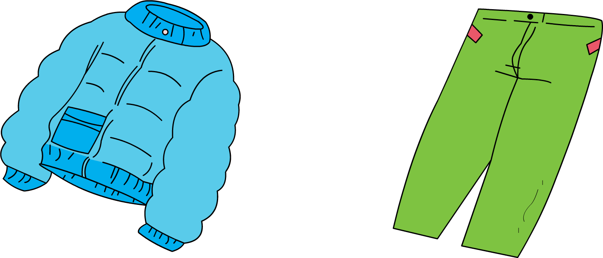
wore
wear
穿
She wore warm clothes.

Slide 5
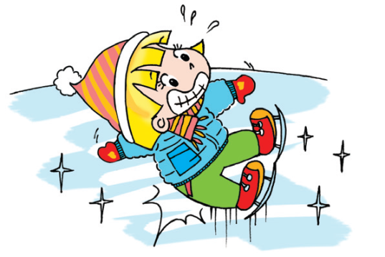
fell over
fall over
摔倒
she didn’t know how to go ice skating, she fell over.

Slide 6
hurt
hurt
(使)受伤
Lucy fell over. But it didn’t hurt.

Slide 7
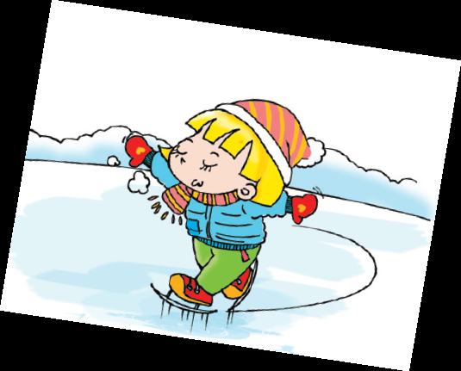
learnt
learn
学习
Then, she learnt to skate, it was easy. She didn’t fall over again.

Slide 8
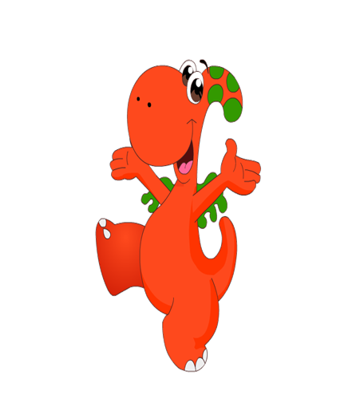
Read and write
Dear Amy,
Yesterday, we went on a school trip.
We went ______. I _____warm clothes.
The ice was very cold.
At first, I ________. But it didn’t ____a lot. Then I __________ skate.
It was easy! And I didn’t _______ again. It was really fun!
Love,
Lucy
skating
wore
fell over
hurt
was able to
fall over

Slide 9
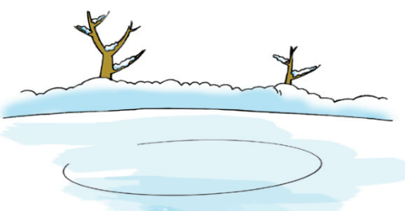
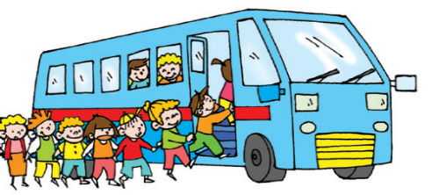
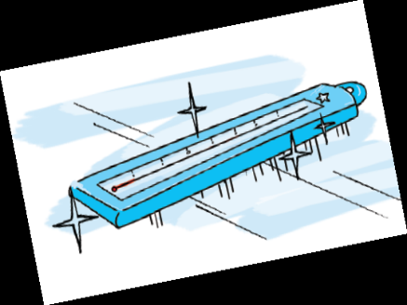
Look and say
Yesterday, Lucy went on a school trip.

Slide 10
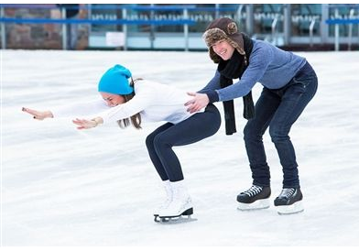
Guessing game
I wore special boots. It was cold.
I fell over a lot. What did I do?
You went ice-skating.

Slide 11
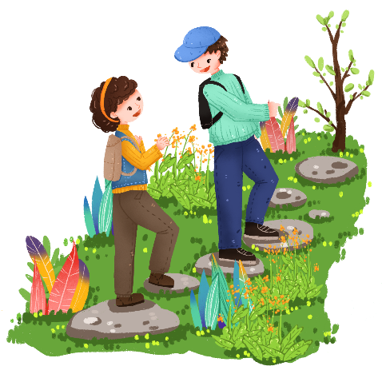
I did it in the countryside. I walked a lot. It was difficult. My legs hurt. What did I do?
You climbed a mountain.

Slide 12
Homework
1.从ear, hear, bear, pear, where, there等单词中找出字母发音
相同的单词，写在作业本上。
2.完成学生课堂活动用书练习2 word search。

